Slide 1
“Earendel --
NASA's James Webb Space Telescope captured a new image of the farthest star ever detected.
The star, nicknamed Earendel, is twice as hot as the sun and about
28 billion light-years away from Earth. It appears as a reddish dot within the Sunrise Arc galaxy. Aug 15, 2023”
ONE LIGHT YEAR = 5,879,000,000,000 miles, or near 6 trillion miles
28 billion light years = 5.879 x 10^12 x 28 x 10^9 = 1.65 x 10^23 miles
= 165,000,000,000,000,000,000,000 miles. Compare with distance to sun:
93,000,000 miles (8.3 light minutes)
So – the furthest star away from earth that we can observe is approximately a 165 billion x one trillion miles away.
This is similar now to the current estimate of number of stars in the known universe: 200 billion x one trillion – and this number grows every year, as telescopes improve and more stars are discovered.

Slide 2
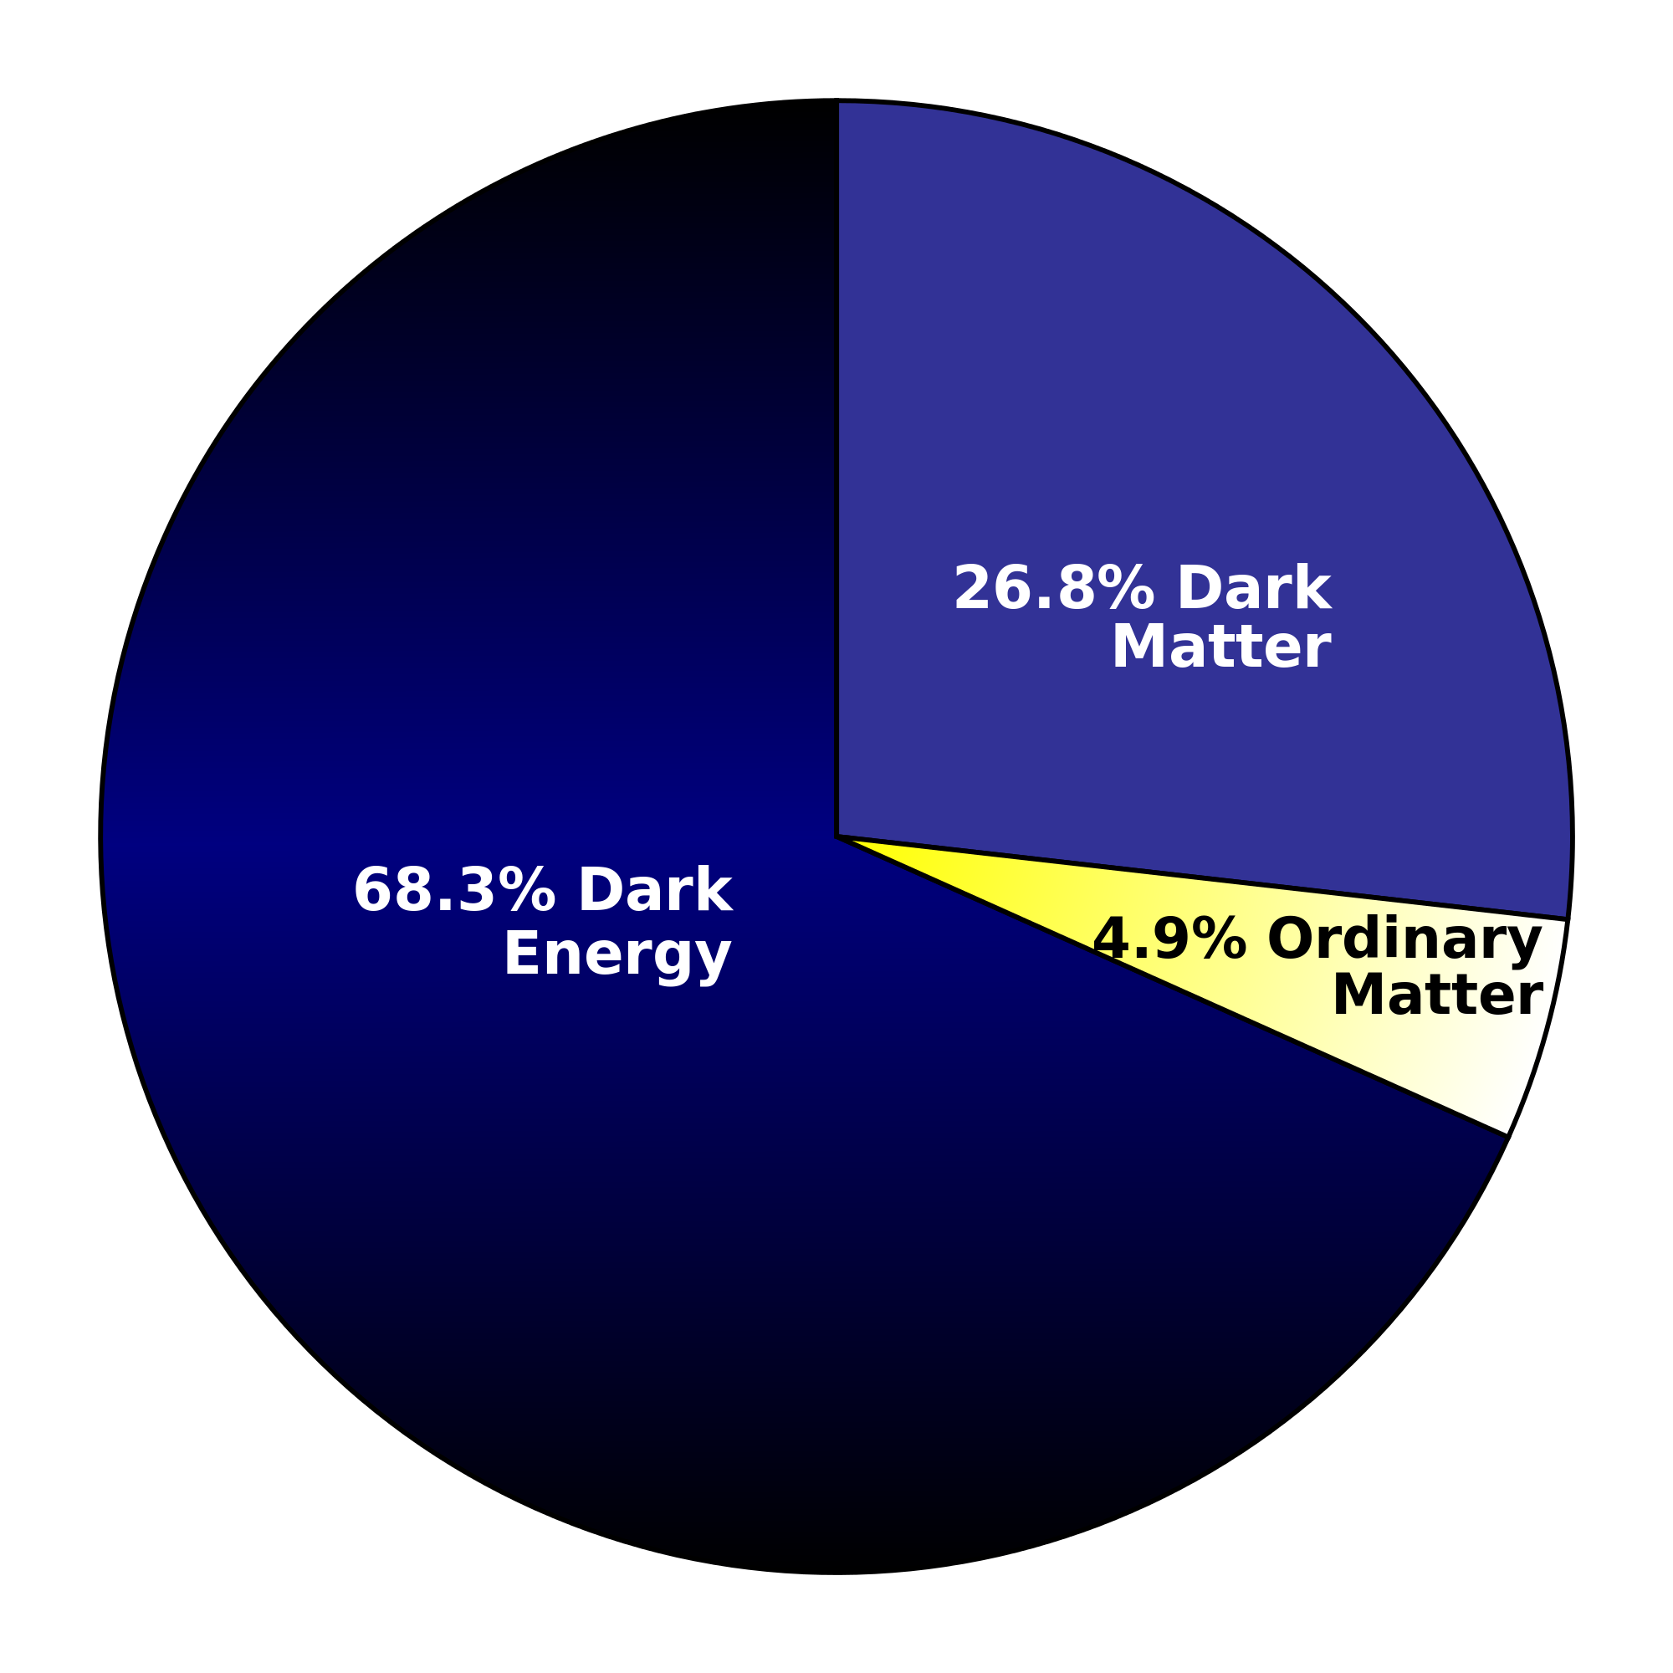
“But it is an important mystery. It turns out that roughly 68% of the universe is dark energy.
Dark matter makes up about 27%.
The rest - everything on Earth, everything ever observed with all of our instruments, all normal matter - adds up to less than 5% of the universe.”
https://science.nasa.gov/astrophysics/focus-areas/what-is-dark-energy/
More than 95% of the universe – we do not understand . . .

Slide 3
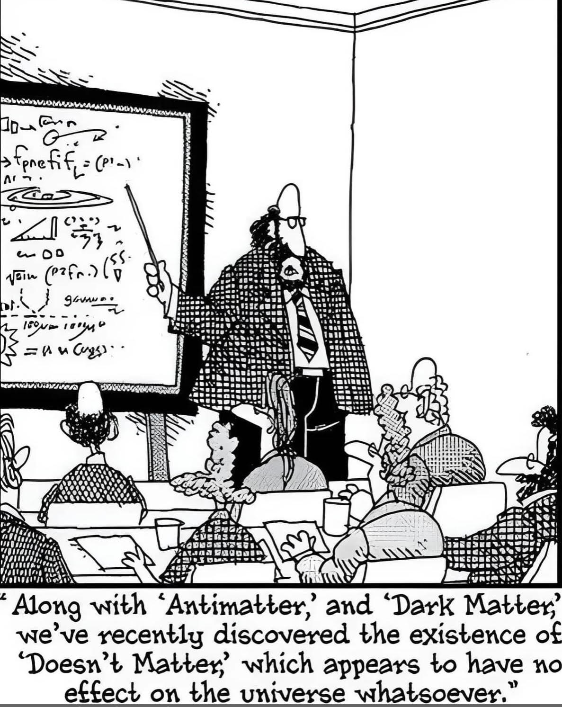

Slide 4
Isaiah 40:12:
Who has measured the waters in the hollow of his hand, or with the breadth of his hand marked off the heavens?
Who has held the dust of the earth in a basket, or weighed the mountains on the scales and the hills in a balance?
Psalm 24:1:
The earth is the Lord’s, and everything in it, the world, and all who live in it.
How do we define – infinite – or eternal ?

Slide 5
Yet in the vastness of space and time:
Isaiah 40:11:
He tends his flock like a shepherd:
He gathers the lambs in his arms and carries them close to his heart;
he gently leads those that have young.

Slide 6
John 3:16:
For God so loved the world,
that he gave his only begotten Son,
that whosoever believeth in him
should not perish,
but have everlasting life.

