Slide 1
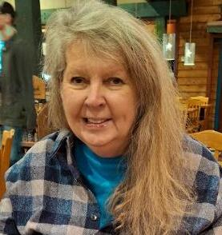
Linda Ruth Holland – Linda Holland Nelson
15 November 1951 – 22 June 2025

Slide 2
Isaiah 40:31
Soaring above challenges and enduring hardship:
But they that wait upon the Lord shall renew their strength; they shall mount up with wings as eagles; they shall run, and not be weary; and they shall walk, and not faint.
Isaiah 41:10
In times of fear and difficulty:
Fear not, for I am with you; be not dismayed, for I am your God; I will strengthen you, I will help you, I will uphold you with my righteous right hand

Slide 3
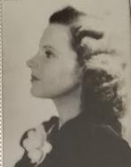
Linda’a Mom, Astrid Elisabeth Johnson (maiden name)

Slide 4
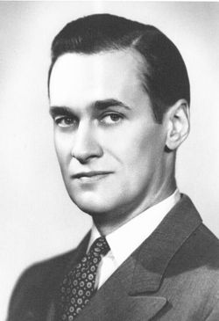
Linda’a Dad, Ray Prunty Holland, Jr.

Slide 5
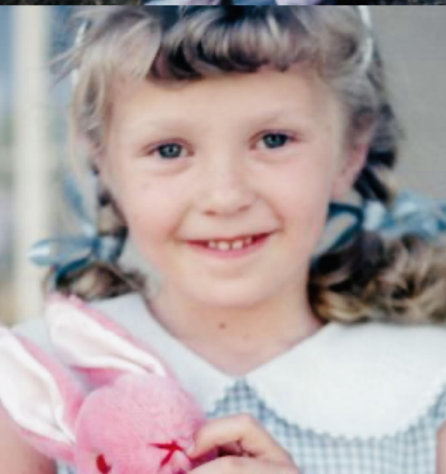
Linda Ruth Holland

Slide 6
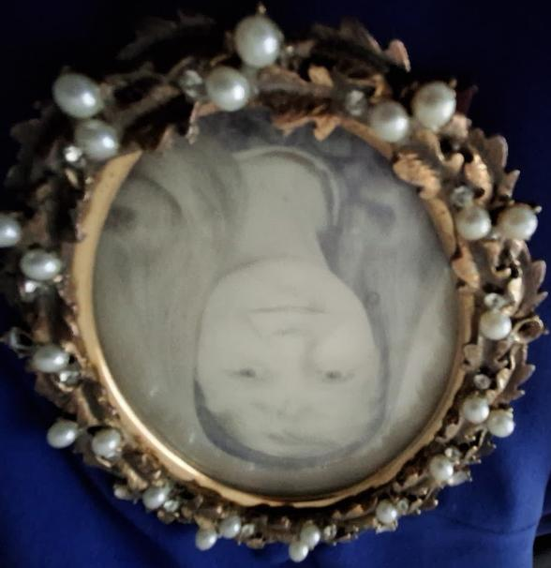

Slide 7
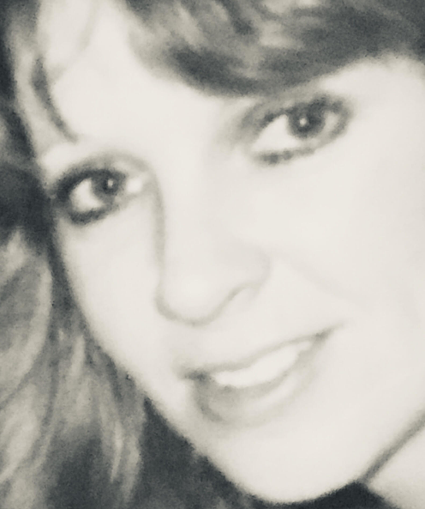

Slide 9
Missouri vs. Holland
1920

Slide 10
The Duck Stamp

Slide 12
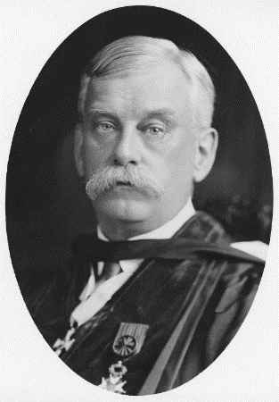
William Jacob Holland
8th Chancellor of the Western University of Pennsylvania (University of Pittsburgh)
In office 1891–1901
Preceded by Milton Goff, Succeeded by Samuel McCormick
Personal details: Born August 16, 1848 Jamaica
Died December 13, 1932 (aged 84)
Pittsburgh, Pennsylvania U.S.
Education Moravian College (BA)
Amherst College (BA)
Rev William Jacob Holland FRSE LLD (August 16, 1848 – December 13, 1932) was the eighth Chancellor of the University of Pittsburgh (1891–1901) and Director of the Carnegie Museums of Pittsburgh.
He was an accomplished lepidopterist, zoologist, and paleontologist, as well as an ordained Presbyterian minister.[1]
Life
Holland was born August 16, 1848, in Jamaica, West Indies, the son of Rev Francis R Holland and his wife, Eliza Augusta Wolle.[2]
Holland was America's great popularizer of butterflies and moths in the first half of the twentieth century. Holland's The Butterfly Book (1898) and The Moth Book (1903) are both still widely used. Holland donated his private collection exceeding 250,000 specimens to the Carnegie Museum.

Slide 13
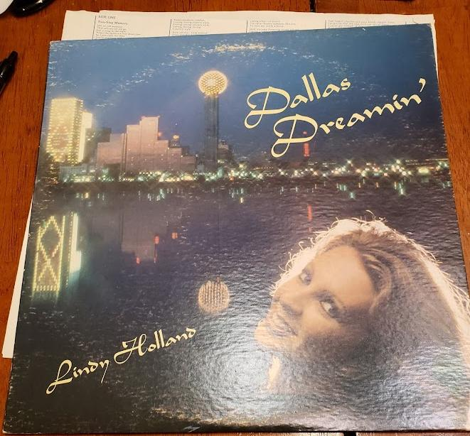
1970 Album

Slide 14
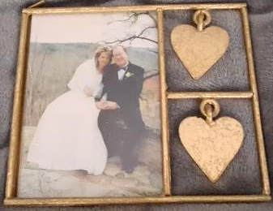
March 29, 2003 – Linda & Steve

Slide 15
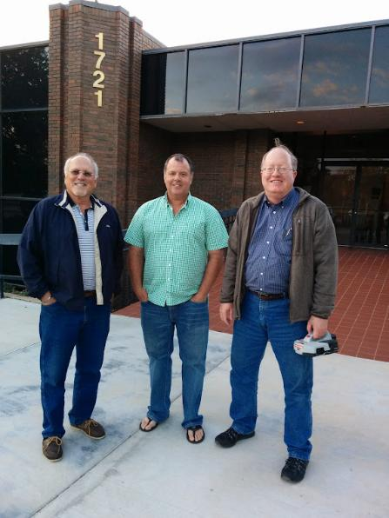
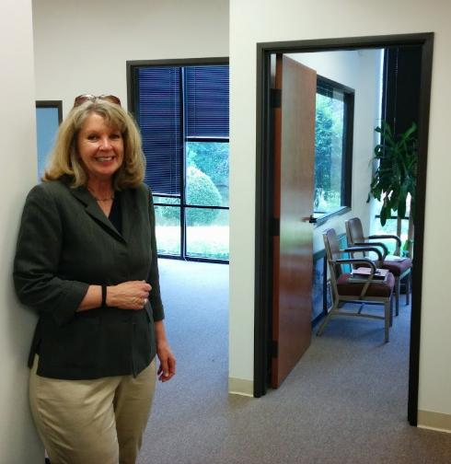
13 Oct 2014 – Jack, Chris, Steve & Linda – ENGIN-IC

Slide 16
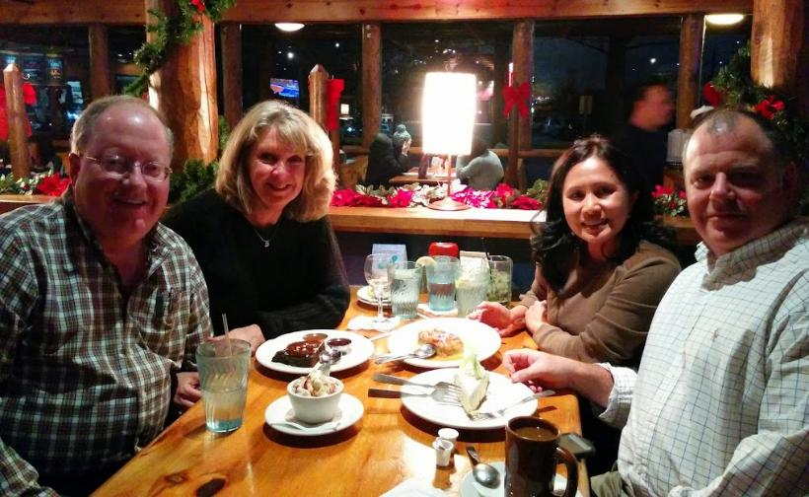
20 Dec 2014 – First ENGIN-IC Party

Slide 17
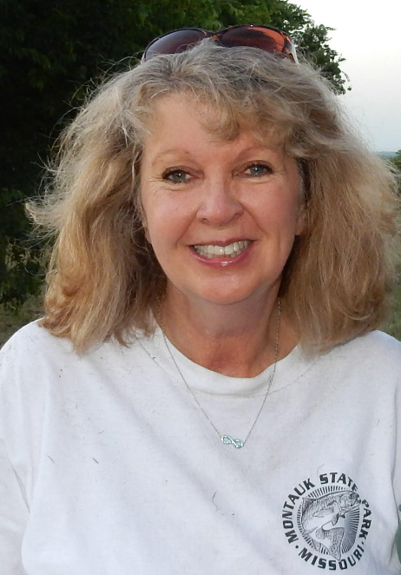
2015

Slide 18
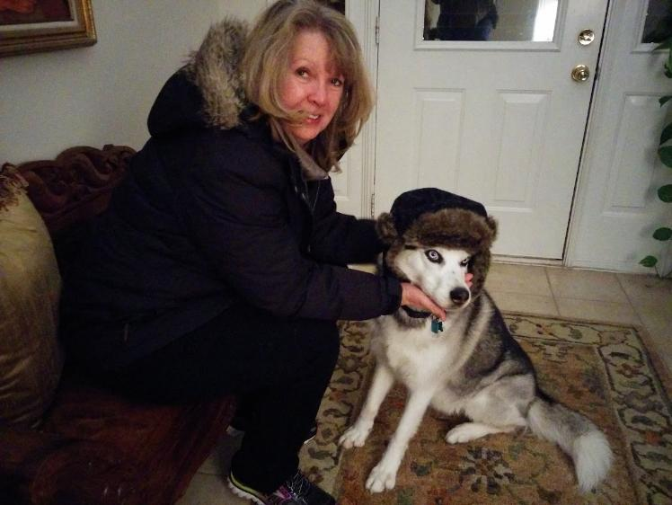
10 Jan 2016 - Linda and Maya

Slide 19
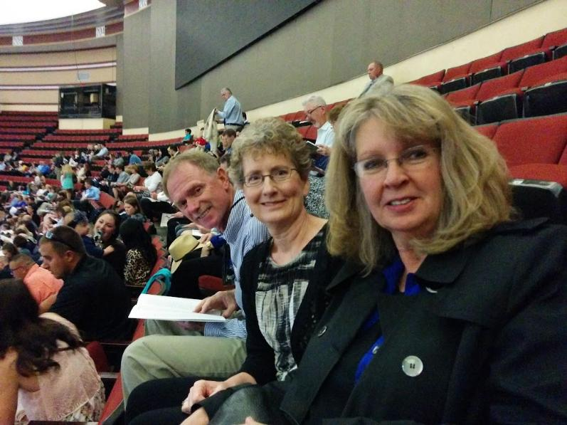
May 14, 2016 – Tom, Karen (Steve’s sister), and Linda

Slide 20
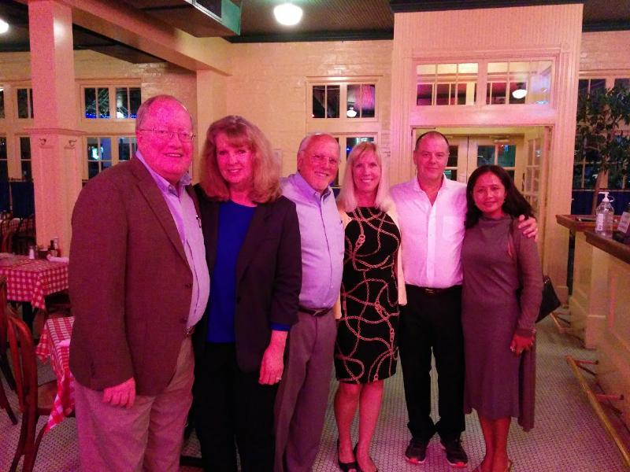
30 Oct 2016

Slide 21
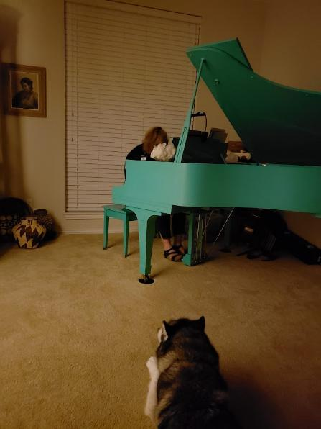
23 May 2018, Linda and Maya at “Turq”

Slide 22
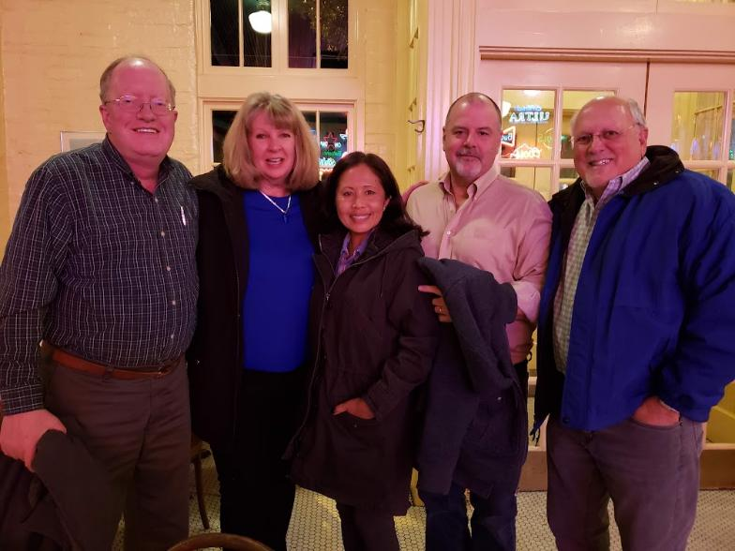
January 2019 – ENGIN-IC Founders

Slide 23
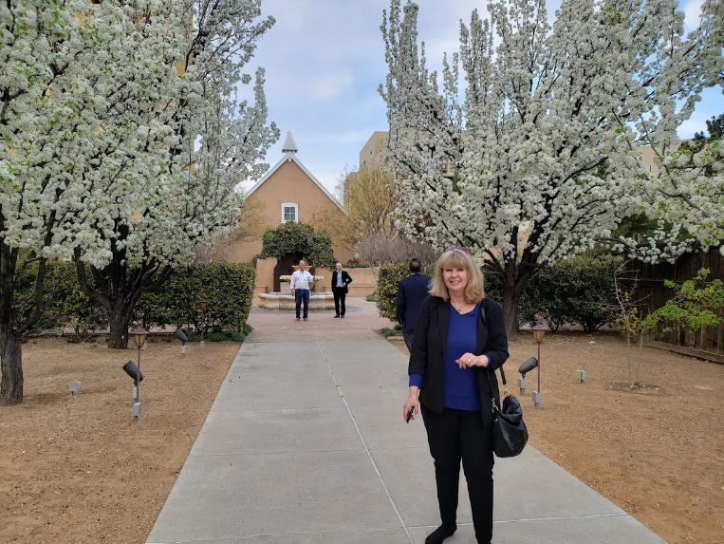
27 March 2019 - Albuquerque, NM

Slide 24
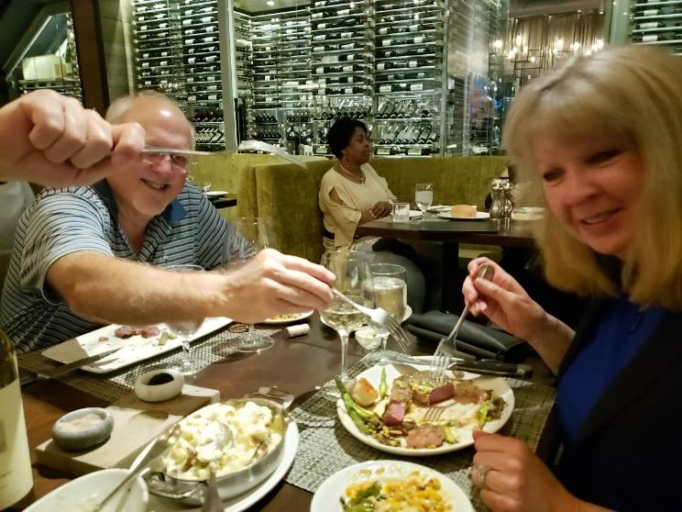
9 April, 2019 - Jack Giles and Linda

Slide 25
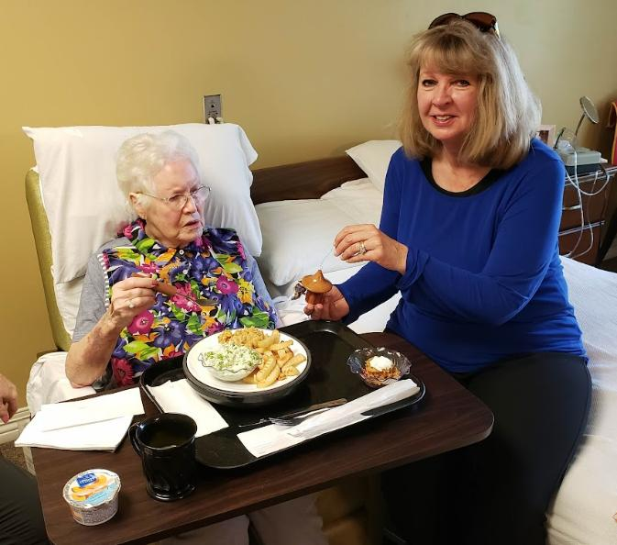
7 June 2019, Judy Nelson and Linda

Slide 26
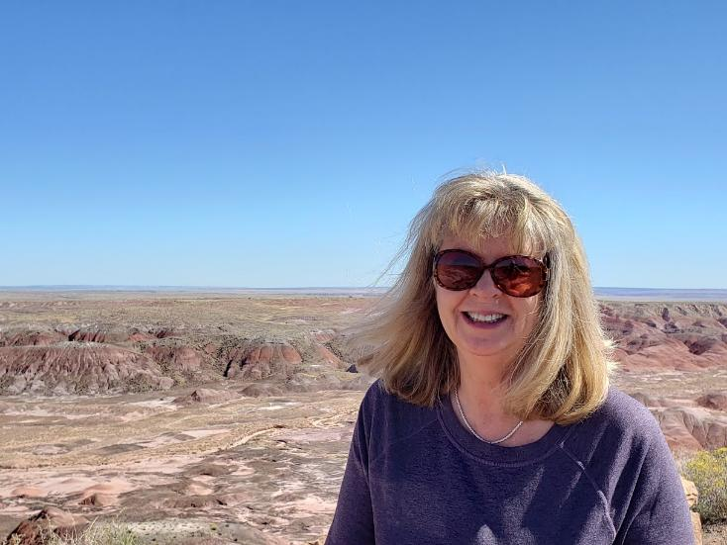
13 Oct 2019, Arizona

Slide 27
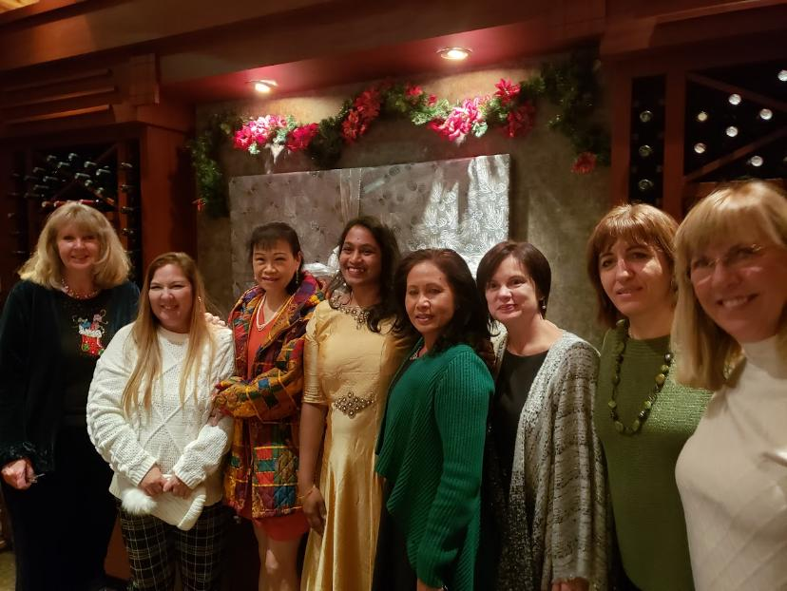
11 Dec 2019, ENGIN-IC Party

Slide 28
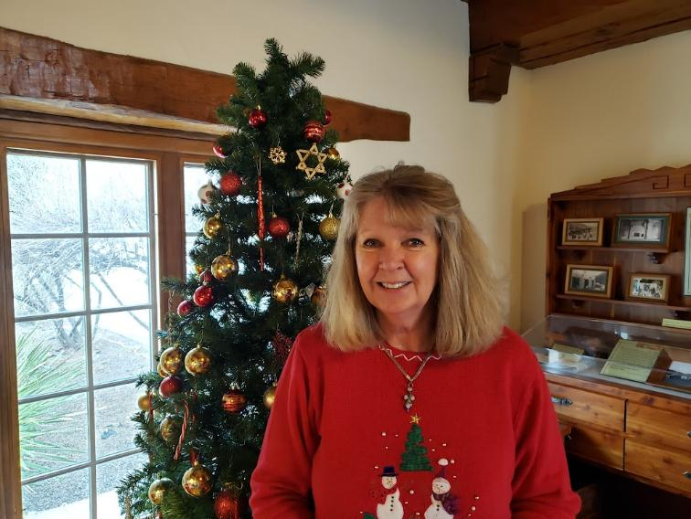
Dec 25, 2019 – Fort Davis, Tx

Slide 29
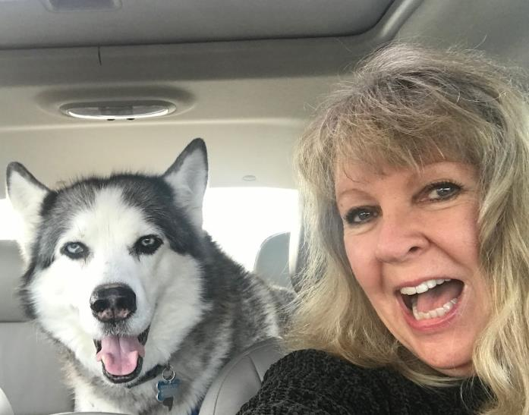
2020 – Maya & Linda

Slide 30
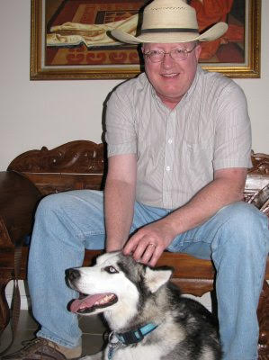
Maya & Steve 2020

Slide 31

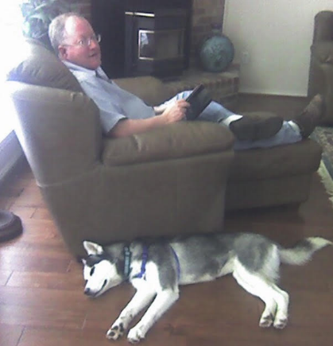
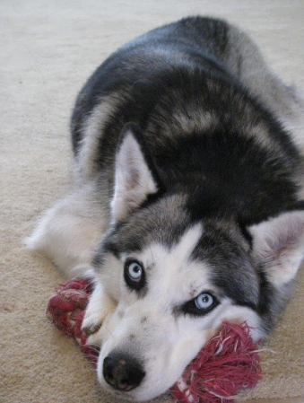

Slide 32
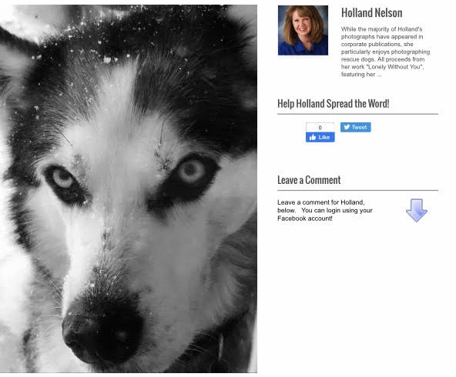
“Snow Dog” –
Maya

Slide 33
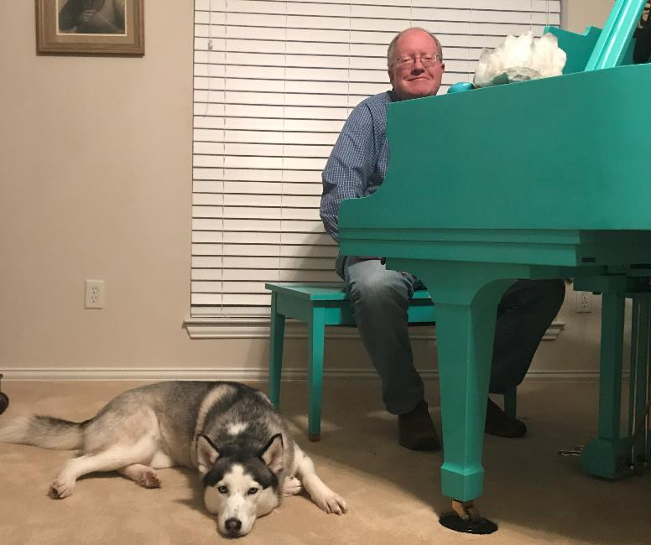

Slide 34
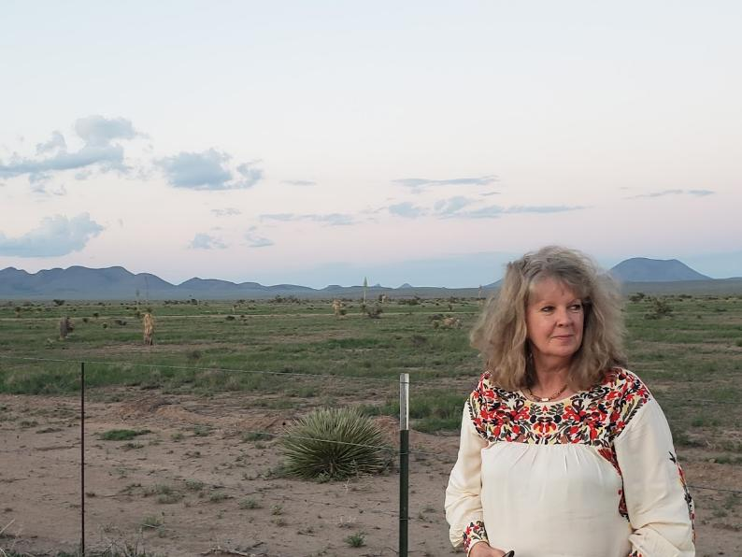
8 July 2021 – New Mexico

Slide 35
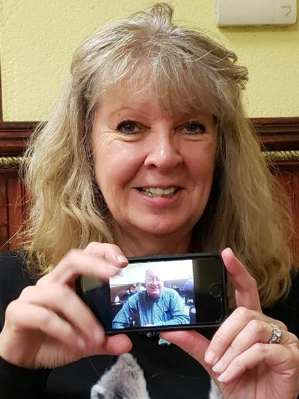
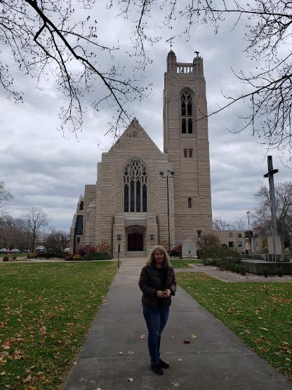
24 Nov 2021 – College of the Ozarks

Slide 36
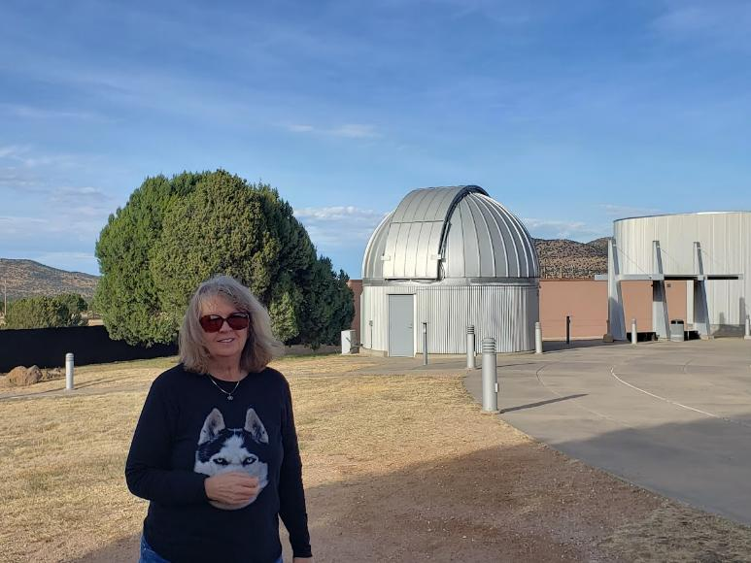
25 Dec 2021 – McDonald Observatory, Fort Davis, Tx

Slide 37
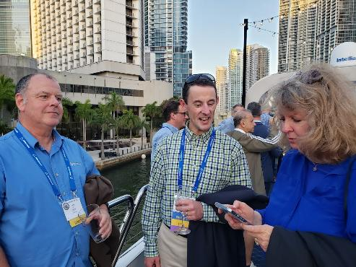
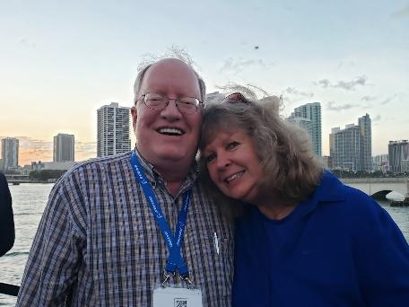
23 Mar 2022 – Miami, Fl

Slide 38
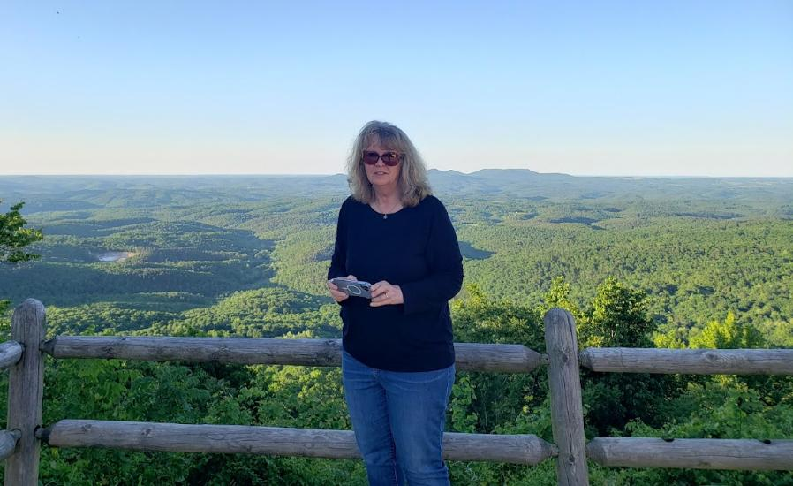
16 May 2022 – Buffalo River Canyon, Arkansas

Slide 39
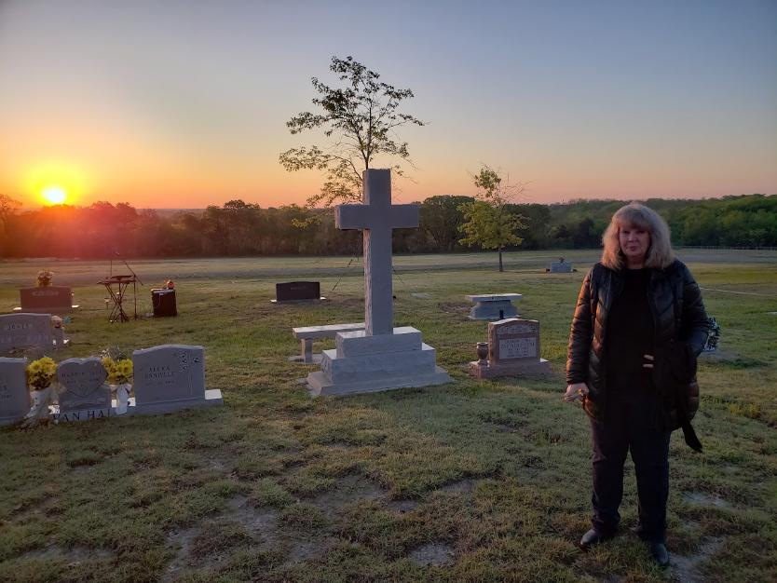
9 April 2023 – Easter Morning, Van Alstyne Cemetery

Slide 40
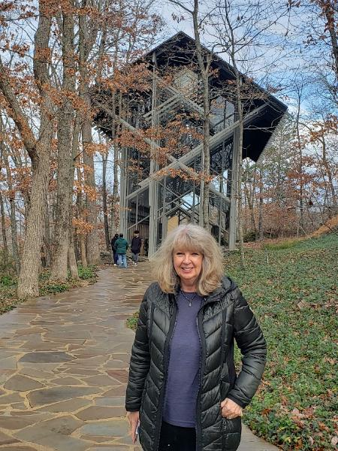
19 Nov 2023 – Thorncrown Chapel – Married there on 29 March 2003

Slide 41
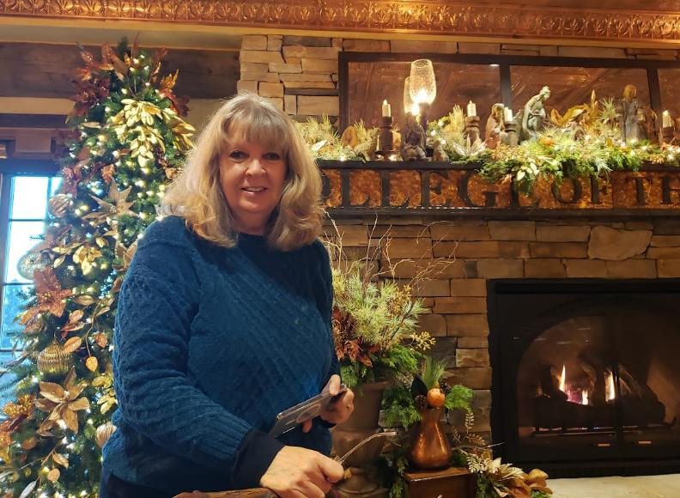
22 Nov 2023 – College of the Ozarks

Slide 42
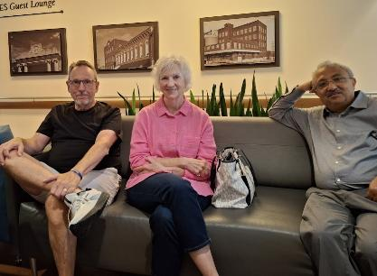
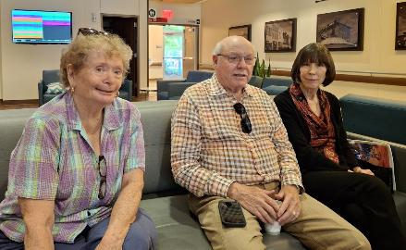
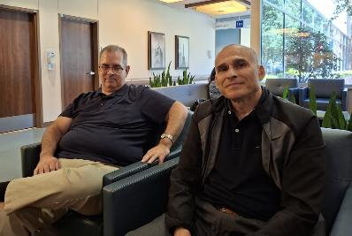
FRIENDS - Surgery Waiting Room – 10 May 2024 – Baylor - McKinney

Slide 43
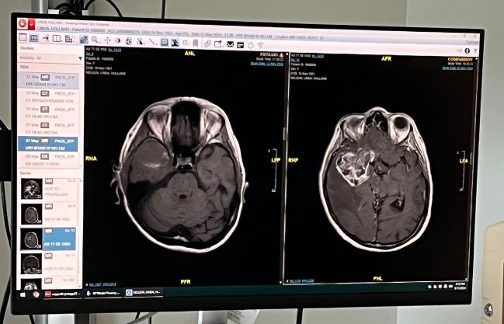
Glioblastoma “wild type”
13 May 2024 – After 10 May surgery (left), and before surgery (right)

Slide 44
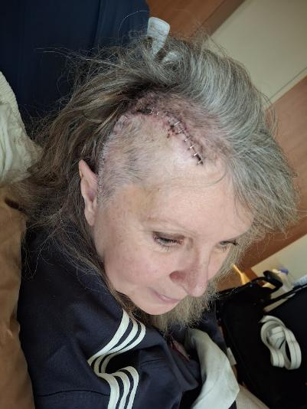
24 May 2024, Two Weeks After Brain Tumor Surgery

Slide 45
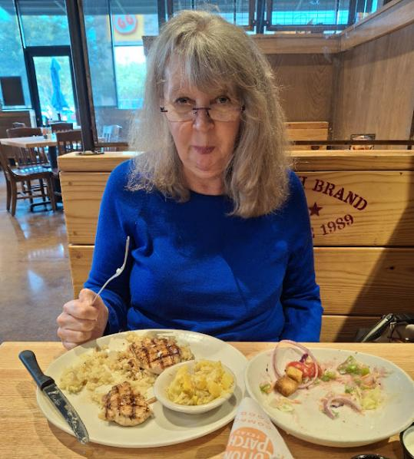
10 June 2024, One Month After Brain Tumor Surgery

Slide 46
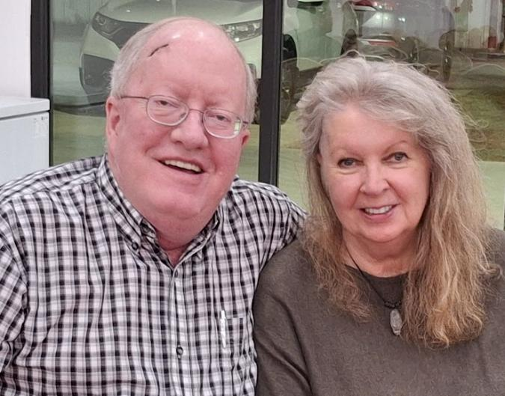
12 Oct 2024

Slide 47
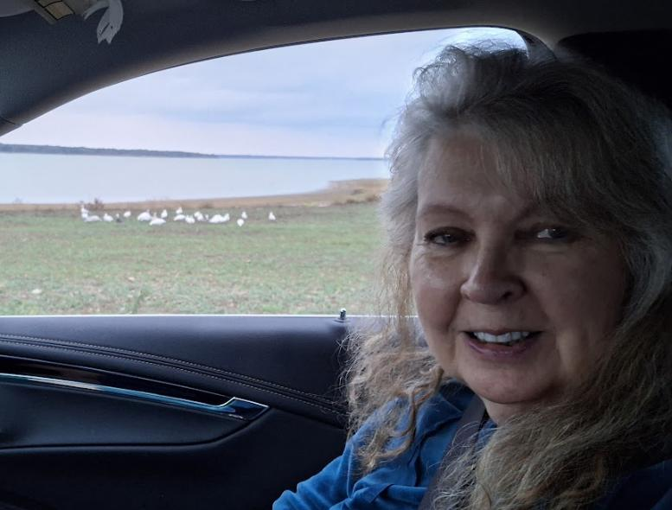
Snow Geese Arrive at Lake Texoma, 2 Nov 2024

Slide 48
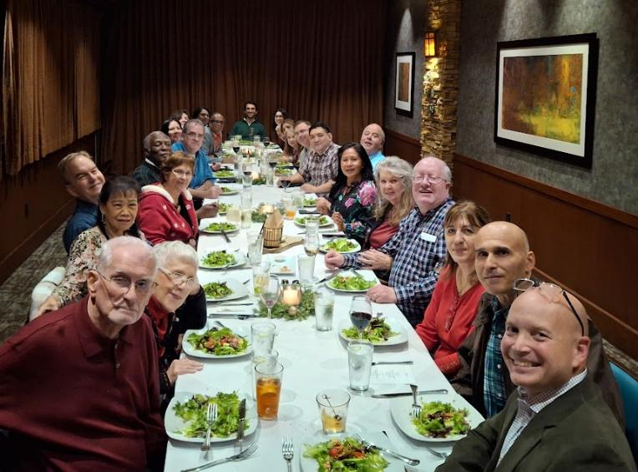
MACOM (ENGIN-IC) Dinner, 10 Dec 2024

Slide 49
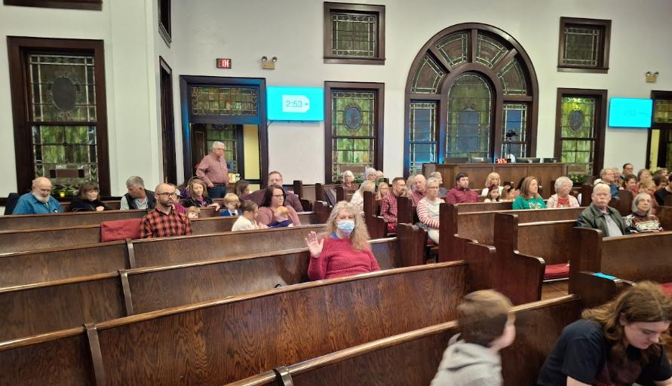
24 Dec 2024 First Christian Church, Van Alstyne

Slide 50

22 January 2025

Slide 51

Linda, Infusion Day, 16 April 2025

Slide 52

Aisha Cole and Linda, Friday, 16 May 2025

Slide 53

Mia and Linda, Thursday, 29 May 2025

Slide 54

Jack and Sally (sister) Hudson, and Linda, Wed, 11 June 2025

