Slide 1


Slide 2


Slide 3
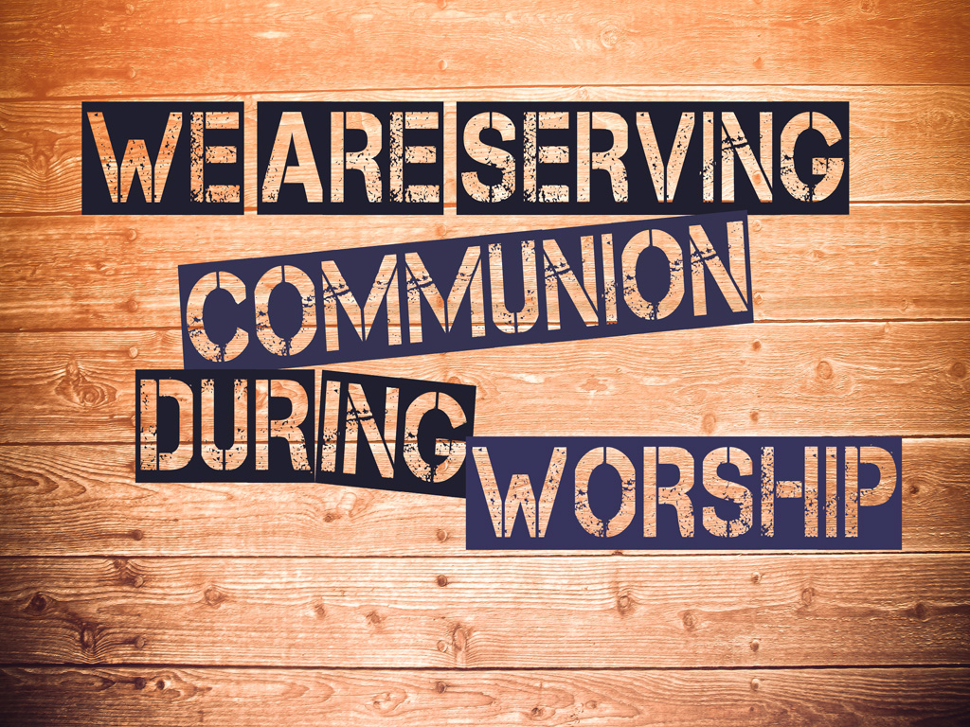


Slide 4


Slide 5


Slide 6


Slide 7


Slide 8


Slide 9
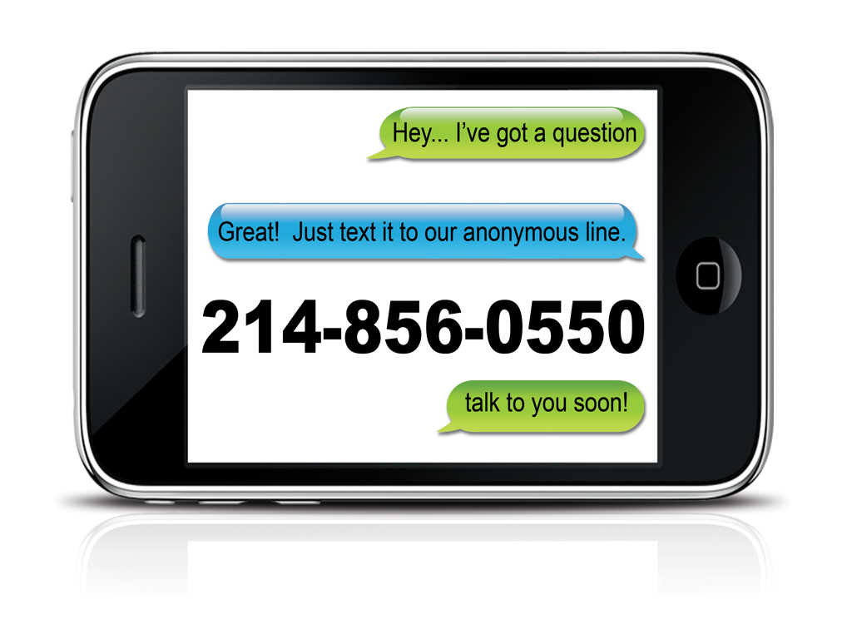

Slide 10


Slide 11
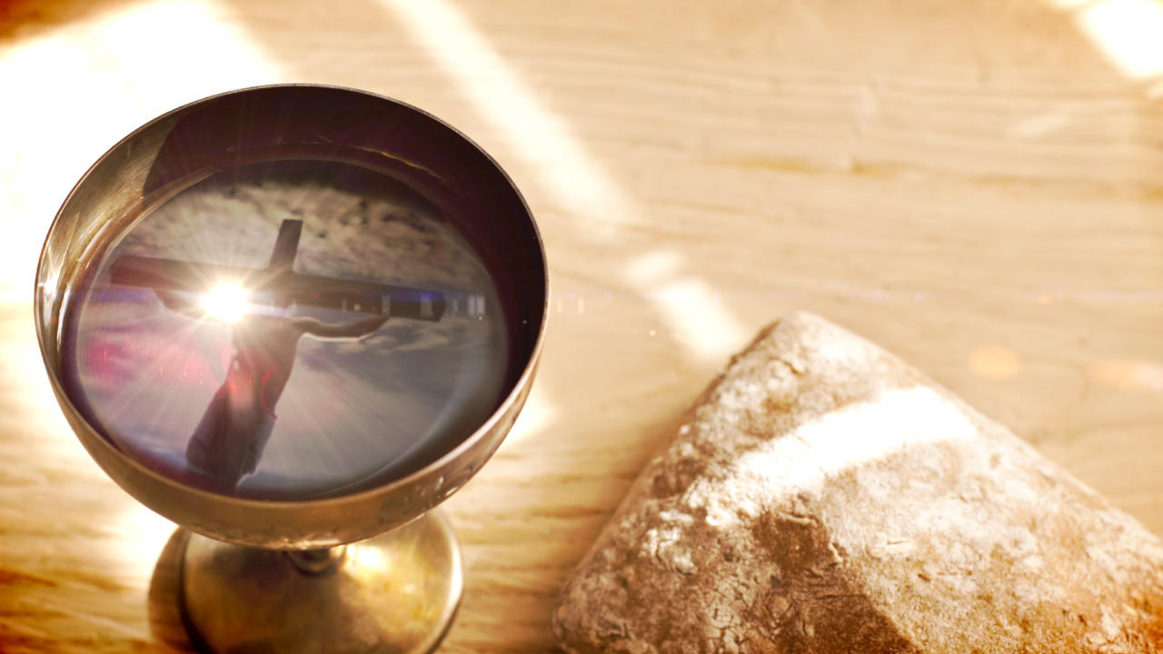
Serve yourself Communion
During Worship.
This do
in remembrance
of me
Communion station
Located Under the
Last Supper Mural

Slide 12

Learn about Redemption Church
Learn about the Mission & Vision
Connect with your Calling

Slide 13
The Next Class is January 19th
Sign up is easy
TEXT - REDCLASS TO 254-717-6844

Slide 14


Slide 15


Slide 16


Slide 17


Slide 18


Slide 19


Slide 20


Slide 21


Slide 22


Slide 23


Slide 24


Slide 25

Let’s CONNECT

Slide 26
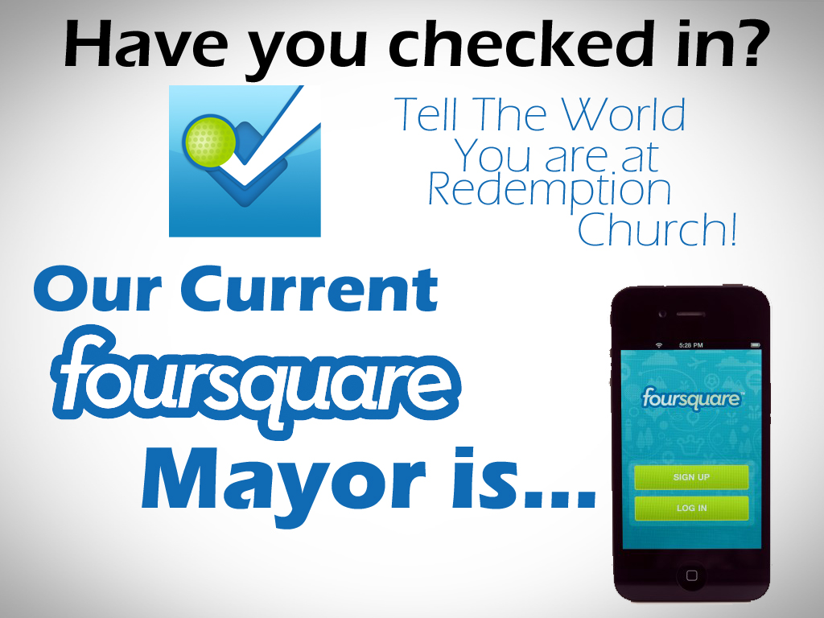

Slide 27


Clyde Fluitt
Check in on Foursquare to become
the Mayor of Redemption Church!

Slide 28
Learn about Redemption Church
Learn about the Mission & Vision
Connect with your Calling

Slide 29
The Next Class is January 19th
Sign up is easy
TEXT - REDCLASS TO 254-717-6844

Slide 38
Serve yourself Communion
During Worship.
This do
in remembrance
of me
Communion station
Located Under the
Last Supper Mural

Slide 39
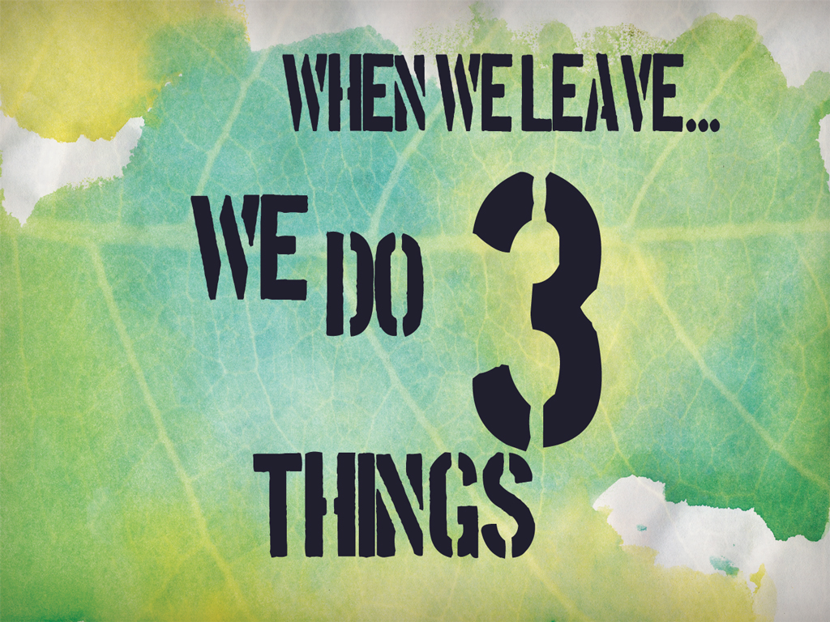

Slide 40


Slide 41


Slide 42
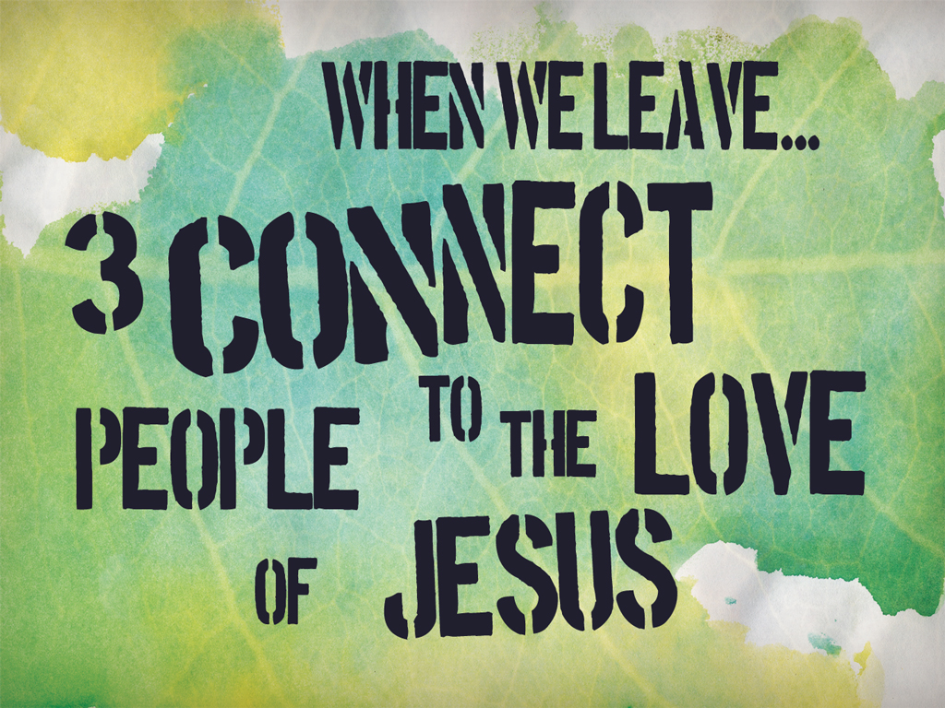

Slide 43


