Slide 1


Slide 2
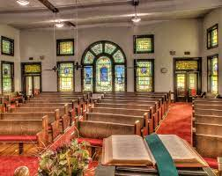
Welcome To First Christian Church May 16th ^{Dr. Doug Deuel} Lesser-Known Stories of the Bible 4: ^{Naaman}

Slide 3
Welcome To First Christian Church May 16th ^{Dr. Doug Deuel} Lesser-Known Stories of the Bible 4: ^{Naaman}
GREETINGS
&
ANNOUNCEMENTS

Slide 4
^{Mellony Deuel} ^{Call To} ^{Worship}
With hearts full of joy, let us give thanks for God’s steadfast love and faithfulness!
O sing to God a new song!
With Songs and celebration, let us bring God our thanks and praise!
O sing to God a new song!
With a joyful noise, let us worship God!
O sing to God a new song!

Slide 5
^{Hymn of Praise} ^{Pg 10} ^{All Verses}
​
A Mighty FortessHim.​ Praise Him."

Slide 6
A mighty fortress is our God, a bulwark never failing Our Helper He, amid the flood
of mortal ills prevailing

Slide 7
For still our ancient foe
doth seek to work us woe His craft and pow’r are great,
and armed with cruel hate On earth is not his equal

Slide 8
Did we in our own strength confide,
our striving would be losing Were not the right Man on our side, the Man of God’s own choosing

Slide 9
Dost ask who that may be? Christ Jesus, it is He The Lord of hosts His name, from age to age the same And He must win the battle

Slide 10
And though this world with devils filled
should threaten to undo us We will not fear, for God hath willed, His truth to triumph through us

Slide 11
The Prince of Darkness grim, we tremble not for him His rage we can endure,
for lo, his doom is sure One little word shall fell him

Slide 12
That word above all earthly pow’rs,
no thanks to them, abideth The Spirit and the gifts are ours through Him who with us sideth

Slide 13
Let goods and kindred go, this mortal life also The body they may kill; God’s truth abideth still His kingdom is forever

Slide 14
His kingdom is forever
His kingdom is forever

Slide 15
Mellony Deuel Invocation
​
Faithful loving God, be with us now. We have gathered to bring you our thanks and praise. We have come to learn your ways of love.

Slide 16
Mellony Deuel Invocation
You have called us to keep your commandments and to love as you love.

Slide 17
Mellony Deuel Invocation
Faithful, loving God, help us remember that our words and actions matter in this world. Guide us to witness to
your ways.

Slide 18
Mellony Deuel Invocation
Lead us to be instruments of your love. With all that we say and do, may our lives resound with songs of joy to you! AMEN Praise Him."

Slide 19
Gloria Patri
Glory be to the Father,
And to the Son, and to the Holy Ghost:
As it was in the beginning,
is now and Ever shall be: world without end.
Amen. Amen

Slide 20

Jessica Snyder

Slide 21

Experiential learning
Grab Ahold

Slide 22
Pastoral Prayer & Prayers of the People
Our Father, who art in heaven, hallowed be your name. Thy kingdom come, Thy will be done, on earth as it is in heaven. Give us this day our daily bread, and forgive us our debts, as we forgive our debtors. Lead us not into temptation, but deliver us from evil, for thine is the kingdom, the power, and the glory, forever, Amen.

Slide 23
^{Hymn of Communion} ^{P902} ^{All Verses}
Nothing but the Blood

Slide 24
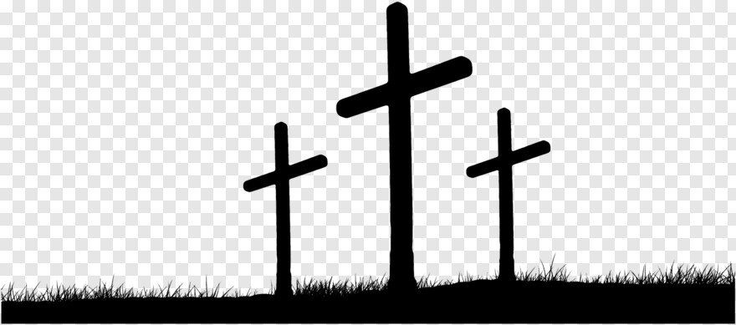
What can wash away my sin? Nothing but the blood of Jesus What can make me whole again? Nothing but the blood of Jesus.

Slide 25
Oh! precious is the flow That makes me white as snow No other fount I know, Nothing but the blood of Jesus.

Slide 26
For my pardon, this I see, Nothing but the blood of Jesus For my cleansing this my plea, Nothing but the blood of Jesus.

Slide 27
Oh! precious is the flow That makes me white as snow No other fount I know, Nothing but the blood of Jesus.

Slide 28
This is all my hope and peace, Nothing but the blood of Jesus This is all my righteousness, Nothing but the blood of Jesus.

Slide 29
Oh! precious is the flow That makes me white as snow No other fount I know, Nothing but the blood of Jesus.

Slide 30
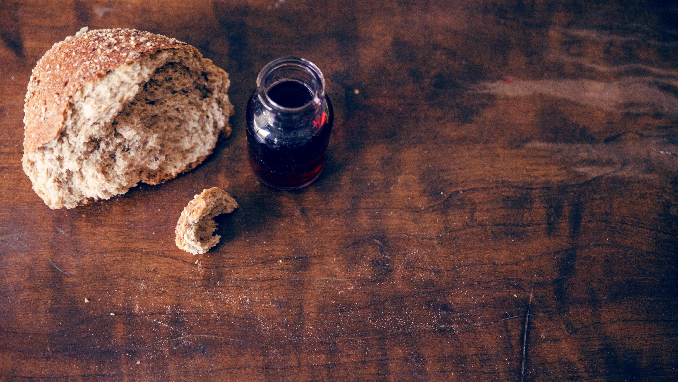
Invitation to the Table
David Salmon & Kathy Cox

Slide 31
Offering Meditation Mellony Deuel
“Our financial gifts enable us to do God’s work in this world. Our offerings enable
us to love and bless our neighbors, both near and far away.

Slide 32
Offering Meditation Mellony Deuel
Financial gifts reflect
faith and commitment. As God has blessed us so generously, let us be generous with God!

Slide 33
Doxology
Praise God, from whom all blessings flow; Praise Him, all Creatures here below; Praise Him above, ye heav’nly host; Praise Father, Son, and Holy Ghost!

Slide 34
Prayer of Dedication Mellony Deuel
Gracious and generous God, You call us to love one another.

Slide 35
Mellony Deuel ^{Scripture} ^{2 Kings 5:1-3}
5 Naaman, commander of the army of the king of Aram, was a great man and in high favor with his master, because by him the LORD had given victory to Aram.

Slide 36
Mellony Deuel ^{Scripture} ^{2 Kings 5:1-3}
The man, though a mighty warrior, suffered from leprosy. 2 Now the Arameans on one of their
raids had taken a young girl captive from the land of Israel, and she served Naaman’s wife.

Slide 37
Mellony Deuel ^{Scripture} ^{2 Kings 5:1-3}
3 She said to her mistress, “If only my lord were with the prophet who is in Samaria! He would cure him of his leprosy.”

Slide 38
^{Special Music}
​
He looked beyond my faults "Praise Him.​ Praise Him."

Slide 39
Amazing Grace will always be my song of praise For it was grace, that brought my liberty

Slide 40
I do not know just why He came to love me so He looked beyond my fault and saw my need

Slide 41
I shall forever lift my eyes to Calvary To view the cross where Jesus died for me

Slide 42
How marvelous the grace that caught my falling soul He looked beyond my fault and saw my need.

Slide 43
Amazing Grace will always be my song of praise For it was grace, that brought my liberty

Slide 44
I do not know just why He came to love me so He looked beyond my fault and saw my need

Slide 45
I shall forever lift my eyes to Calvary To view the cross where Jesus died for me

Slide 46
How marvelous the grace that caught my falling soul He looked beyond my fault and saw my need.

Slide 47
How marvelous the grace that caught my falling soul He looked beyond my fault and saw my need.

Slide 48
^{Dr. Doug Deuel} Lesser-Known Stories of the Bible 4: ^{The Story of Naaman}

Slide 49
^{Hymn of} ^{Invitation} ^{P659} ^{All Verses}
​
I love to tell the story "Praise Him.​ Praise Him."

Slide 50
I love to tell the story
Of unseen things above,
Of Jesus and His glory,
Of Jesus and His love.

Slide 51
I love to tell the story,
Because I know ’tis true;
It satisfies my longings
As nothing else can do.

Slide 52
I love to tell the story,
’Twill be my theme in glory
To tell the old, old story
of Jesus and His love.

Slide 53
I love to tell the story;
More wonderful it seems
Than all the golden fancies
Of all my golden dreams,

Slide 54
I love to tell the story,
It did so much for me;
And that is just the reason
I tell it now to thee.

Slide 55
I love to tell the story,
’Twill be my theme in glory
To tell the old, old story
of Jesus and His love.

Slide 56
I love to tell the story;
’Tis pleasant to repeat
What seems each time I tell it,
More wonderfully sweet.

Slide 57
I love to tell the story; For some have never heard
The message of salvation
From God’s own holy Word.

Slide 58
I love to tell the story,
’Twill be my theme in glory
To tell the old, old story
of Jesus and His love.

Slide 59
To tell the old, old story
of Jesus and His love.

Slide 60
Benediction Dr Doug Deuel

Slide 61


