Slide 1


Slide 2
Welcome To First Christian Church May 30th ^{Trea Madole} ^{“The Gospel”}
GREETINGS
&
ANNOUNCEMENTS

Slide 3
^{Special Music}
​
Total Praise"Praise Him.​ Praise Him."

Slide 4
Lord, I will lift my eyes to the hills
Knowing my help is coming from You
Your peace You give me in time of the storm

Slide 5
You are the source of my strength
You are the strength of my life
I lift my hands in total praise to You

Slide 6
You are the source of my strength
You are the strength of my life
I lift my hands in total praise to You

Slide 7
Amen

Slide 8
You are the source of my strength
You are the strength of my life
I lift my hands in total praise to You

Slide 9
Amen

Slide 10
^{Bradley Gee} ^{Call To} ^{Worship}
Let us give thanks to God for the land of our birth with all its chartered liberties. For all the wonder of our country's story: WE GIVE YOU THANKS, O GOD.
For leaders in nation and state, and for those who in days past and in these present times have labored for the commonwealth: WE GIVE YOU THANKS, O GOD.

Slide 11
^{Bradley Gee} ^{Call To} ^{Worship}
For those who in all times and places have been true and brave, and in the worlds common ways have lived upright lives and ministered to their fellows:
WE GIVE YOU THANKS, O GOD.

Slide 12
^{Hymn of Praise} ^{Pgs 266}
​
MajestyPraise Him."

Slide 13
Majesty Worship His Majesty
Unto Jesus Be all glory, honor, and praise

Slide 14
Majesty, Kingdom authority
Flow from His throne,
Unto His own
His anthem raise

Slide 15
So exalt, lift up on high The name of Jesus Magnify, come glorify Christ Jesus the King

Slide 16
Majesty, Worship His majesty
Jesus, who died,
Now glorified
King of all kings

Slide 17
So exalt, lift up on high The name of Jesus Magnify, come glorify Christ Jesus the King

Slide 18
Majesty, Worship His majesty
Jesus, who died,
Now glorified
King of all kings

Slide 19
Jesus, who died,
Now glorified
King of all kings

Slide 20
Bradley Gee Invocation
​
O almighty God and most merciful Father, as we remember these your servants, remembering with gratitude their courage and strength, we hold before you those who mourn them.

Slide 21
Bradley Gee Invocation
​
Look upon your bereaved servants with your mercy. As this day brings them memories of those they have lost awhile,

Slide 22
Bradley Gee Invocation
​
may it also bring your consolation and the assurance that their loved ones are alive now and forever in your living presence.
AMEN

Slide 23
Gloria Patri
Glory be to the Father,
And to the Son, and to the Holy Ghost:
As it was in the beginning,
is now and Ever shall be: world without end.
Amen. Amen

Slide 24

Jessica Snyder

Slide 25
Pastoral Prayer & Prayers of the People
Our Father, who art in heaven, hallowed be your name. Thy kingdom come, Thy will be done, on earth as it is in heaven. Give us this day our daily bread, and forgive us our debts, as we forgive our debtors. Lead us not into temptation, but deliver us from evil, for thine is the kingdom, the power, and the glory, forever, Amen.

Slide 26
^{Hymn of Communion} ^{P324} ^{Vs 1,2,4}
Alas and did my savior bleed

Slide 27

Alas! and did my Savior bleed
And did my Sov’reign die?
Would He devote that sacred head for such a worm as I?

Slide 28
At the cross, at the cross
Where I first saw the light,
And the burden of my heart rolled away

Slide 29
It was there by faith
I received my sight,
And now I am happy all the day!

Slide 30
Was it for crimes
That I had done,
He groaned upon the tree?
Amazing pity! Grace unknown!
And love beyond degree!

Slide 31
At the cross, at the cross
Where I first saw the light,
And the burden of my heart rolled away

Slide 32
It was there by faith
I received my sight,
And now I am happy all the day!

Slide 33
But drops of grief
Can ne’er repay
The debt of love I owe:
Here, Lord, I give myself away,
’Tis all that I can do.

Slide 34
At the cross, at the cross
Where I first saw the light,
And the burden of my heart rolled away

Slide 35
It was there by faith
I received my sight,
And now I am happy all the day!

Slide 36
It was there by faith
I received my sight,
And now I am happy all the day!

Slide 37
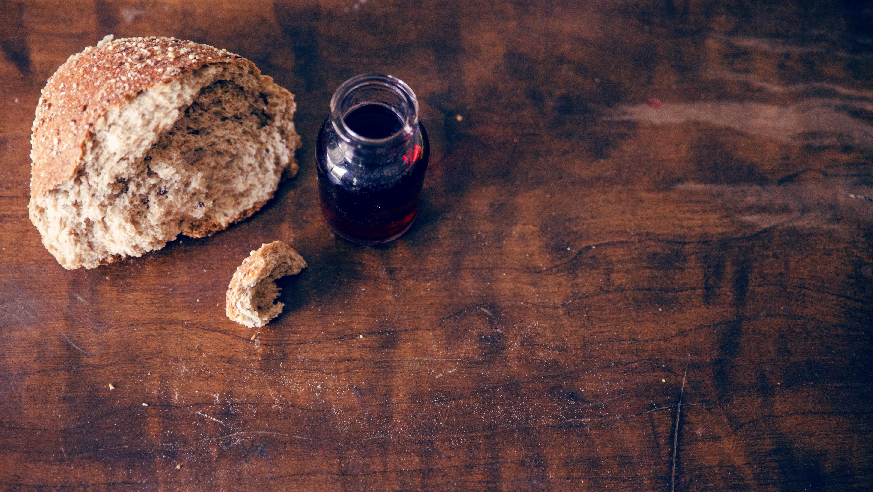
Invitation to the Table
David Salmon & Gayle Flanery

Slide 38
Offering Meditation Bradley Gee
O Sovereign of the universe, we stand in your temple, proclaiming your splendor and majesty. You are the Holy One! You are full of glory!

Slide 39
Offering Meditation Bradley Gee
You Speak, and the oaks whirl and the cedars fall. We stand in your presence in awe and humility. We stand in your presence with boldness and courage.

Slide 40
Offering Meditation Bradley Gee
We look and listen for your presence here today.
AMEN

Slide 41
Doxology
Praise God, from whom all blessings flow; Praise Him, all Creatures here below; Praise Him above, ye heav’nly host; Praise Father, Son, and Holy Ghost!

Slide 42
Prayer of Dedication Bradley Gee
It is only because of Jesus Christ that we are bold enough to call you Father, oh Sovereign of the Universe.

Slide 43
Prayer of Dedication Bradley Gee
We do so now, to remind ourselves of our many sisters and brothers, your many children, who need hope and care.

Slide 44
Prayer of Dedication Bradley Gee
Use our gifts to reach others with the story of your great love for our world.
AMEN

Slide 45
Bradley Gee ^{Scripture} ^{1 Corinthians 15:1-4}
Now I would remind you, brothers and sisters, of the good news that I proclaimed to you, which you in turn received, in which also you stand,

Slide 46
Bradley Gee ^{Scripture} ^{1 Corinthians 15:1-4}
2 through which also you are being saved, if you hold firmly to the message that I proclaimed to you—unless you have come to believe in vain.

Slide 47
Bradley Gee ^{Scripture} ^{1 Corinthians 15:1-4}
3 For I handed on to you as of first importance what I in turn had received: that Christ died for our sins in accordance with the scriptures,

Slide 48
Bradley Gee ^{Scripture} ^{1 Corinthians 15:1-4}
4 and that he was buried, and that he was raised on the third day in accordance with the scriptures,

Slide 49
^{Special Music}
​
Good Good Father"Praise Him.​ Praise Him."

Slide 50
I've heard a thousand stories of what they think you're like
But I've heard the tender whisper of love in the dead of night

Slide 51
And you tell me
that you're pleased
And that I'm never alone

Slide 52
You're a Good, Good Father
It's who you are, it's who you are, it's who you are
And I'm loved by you
It's who I am, it's who I am, it's who I am

Slide 53
I've seen many searching
for answers far and wide
But I know we're all searching
For answers only you provide

Slide 54
'Cause you know
just what we need
Before we say a word

Slide 55
You're a Good, Good Father
It's who you are, it's who you are, it's who you are
And I'm loved by you
It's who I am, it's who I am, it's who I am

Slide 56
You are perfect
in all of your ways
You are perfect
in all of your ways
You are perfect
in all of your ways to us

Slide 57
You are perfect
in all of your ways
You are perfect
in all of your ways
You are perfect
in all of your ways to us

Slide 58
It's love so undeniable
I, I can hardly speak
Peace so unexplainable
I, I can hardly think

Slide 59
As you call me deeper still
As you call me deeper still
As you call me deeper still
Into love, love, love

Slide 60
You're a Good, Good Father
It's who you are, it's who you are, it's who you are
And I'm loved by you
It's who I am, it's who I am, it's who I am

Slide 61
You are perfect
in all of your ways
You are perfect
in all of your ways
You are perfect
in all of your ways to us

Slide 62
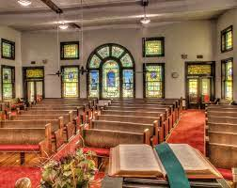
^{Trea Madole} ^{“The Gospel”}

Slide 63
^{Hymn of} ^{Invitation} ^{P71}
As The Deer

Slide 64
As the deer panteth for the water
So my soul longs after You
You alone are my hearts desire and I long to worship You

Slide 65
You alone are my strength, my shield, to You alone may my spirit yield
You alone are my hearts desire and I long to worship You

Slide 66
I want You more than gold or silver
Only You can satisfy
You alone are the real joy giver and the apple of my eye

Slide 67
You alone are my strength, my shield, to You alone may my spirit yield
You alone are my hearts desire and I long to worship You

Slide 68
You alone are my strength, my shield, to You alone may my spirit yield
You alone are my hearts desire and I long to worship You

Slide 69
Benediction Trea Madole

Slide 70


