Slide 1


Slide 2
Welcome To First Christian Church
June 6th
^{Dr. Doug Deuel}
^{“Am I in the Wrong Race”}
GREETINGS
&
ANNOUNCEMENTS

Slide 3
^{Collin Flynn}
^{Call To}
^{Worship}
Come to the Lord.
We will walk in the light of faith.
Come to the Lord.
We will love in the light of faith.

Slide 4
^{Collin Flynn}
^{Call To}
^{Worship}
Come to the Lord.
We will sing in the light of the Lord.
Come to the Lord.
We will live in the light of the Lord.

Slide 5
^{Hymn of Praise}
^{Pgs 715}
​
The Church’s One Foundation

Slide 6
The church’s one foundation
is Jesus Christ her Lord;
She is a new creation
by water and the Word.

Slide 7
From heav’n He came and sought her to be His holy bride;
With His own blood he bought her, and for her life He died.

Slide 8
Elect from ev’ry nation
Yet one o’er all the earth;
Her charter of salvation,
one Lord, one faith,
one birth;

Slide 9
One holy name she blesses,
Partakes one holy food,
And to one hope she presses,
With every grace endued.

Slide 10
Mid toil and tribulation,
And tumult of her war;
She waits the consummation
of peace forevermore.
‘Till with the vision glorious, Her longing eyes are blest

Slide 11
And the great church victorious
Shall be the church at rest

Slide 12
Collin Flynn
Invocation
​
Be Thou our vision, O God. Help us walk by faith, not by sight. Like Samuel before us, remind us once more that you do not see as mortals see,
for you do not judge by outward appearances,

Slide 13
Collin Flynn
Invocation
​But look on the heart.
Create a clean heart within us, O God, that we may see your kingdom in a tiny mustard seed and marvel at the simple beauty of our world and our lives.

Slide 14
Gloria Patri
Glory be to the Father,
And to the Son, and to the Holy Ghost:
As it was in the beginning,
is now and Ever shall be: world without end.
Amen. Amen

Slide 15

Evan Snyder

Slide 16
Pastoral Prayer
&
Prayers of the
People
Our Father, who art in heaven, hallowed be your name. Thy kingdom come, Thy will be done, on earth as it is in heaven. Give us this day our daily bread, and forgive us our debts, as we forgive our debtors. Lead us not into temptation, but deliver us from evil, for thine is the kingdom, the power, and the glory, forever, Amen.

Slide 17
^{Hymn of Communion}
^{P490}
It is Well with My Soul

Slide 18

When peace, like a river, attendeth my way,
When sorrows like sea billows roll;
Whatever my lot,
Thou hast taught me to say,

Slide 19
It is well, it is well with my soul.

Slide 20
It is well with my soul,
It is well, it is well with my soul.

Slide 21
My sin, oh, the bliss of this glorious thought!
My sin, not in part but the whole,
Is nailed to the cross, and I bear it no more,

Slide 22
Praise the Lord, praise the Lord, O my soul!

Slide 23
It is well with my soul,
It is well, it is well with my soul.

Slide 24
And Lord, haste the day when the faith shall be sight,
The clouds be rolled back as a scroll;
The trump shall resound, and the Lord shall descend,

Slide 25
Even so, it is well with my soul.

Slide 26
It is well with my soul,
It is well, it is well with my soul.

Slide 27
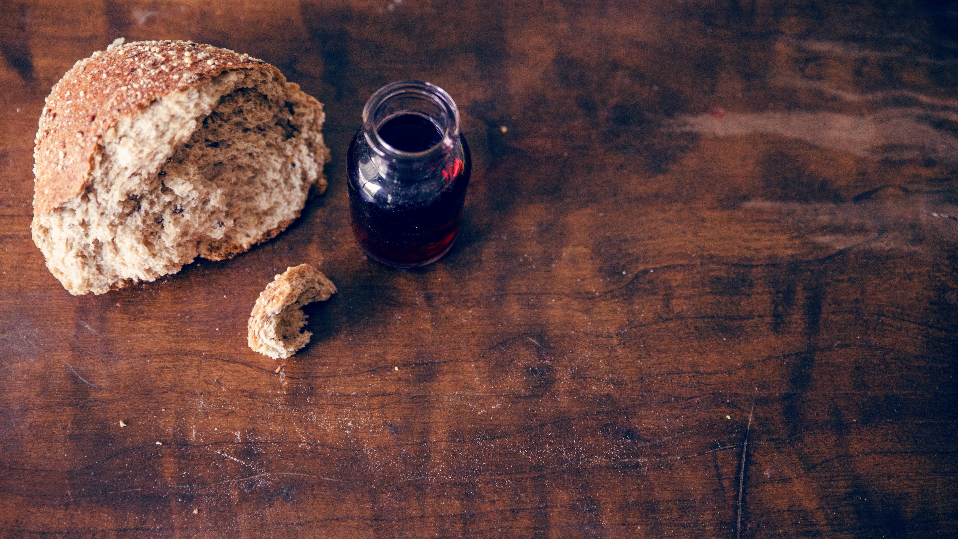
Invitation to the Table
Linda Wood & Cathy Cox

Slide 28
Offering
Meditation
Collin Flynn
Bountiful God, your Kingdom is like seed that someone scatters on the ground. How it grows, we know not, but there is abundance in the harvest.

Slide 29
Offering
Meditation
Collin Flynn
Your kingdom
is like a tiny mustard seed that grows into a shrub where the birds of the air build
their nests.

Slide 30
Doxology
Praise God, from whom all blessings flow; Praise Him, all Creatures here below; Praise Him above, ye heav’nly host; Praise Father, Son, and Holy Ghost!

Slide 31
Prayer of
Dedication
Collin Flynn
May the gifts we bring bear as much fruit as the seeds of your kingdom, that all may be fed and all may be blessed. AMEN

Slide 32
Collin Flynn
^{Scripture}
^{Mark 8:31-38}
31 Then he began to teach them that the Son of Man must undergo great suffering, and be rejected by the elders, the chief priests, and the scribes, and be killed, and after 3 days rise again.

Slide 33
Collin Flynn
^{Scripture}
^{Mark 8:31-38}
32 He said all this quite openly. And Peter took him aside and began to rebuke him. 33 But turning and looking at his disciples, he rebuked Peter and said, “Get behind me, Satan!

Slide 34
Collin Flynn
^{Scripture}
^{Mark 8:31-38}
For you are setting your mind not on divine things but on human things.”
34 He called the crowd with his disciples, and said to them, “If any want to become my followers, let them deny themselves

Slide 35
Collin Flynn
^{Scripture}
^{Mark 8:31-38}
and take up their cross and follow me. 35 For those who want to save their life will lose it, and those who lose their life for my sake, and for
the sake of the gospel, will save it.

Slide 36
Collin Flynn
^{Scripture}
^{Mark 8:31-38}
36 For what will it profit them to gain the whole world and forfeit their life? 37 Indeed, what can they give in return for their life?

Slide 37
Collin Flynn
^{Scripture}
^{Mark 8:31-38}
Those who are ashamed of me and of my words in this adulterous and sinful generation, of them the Son of Man will also be ashamed when he comes in the glory of his Father with the holy angels.”

Slide 38
^{Special Music}
​
The Lord’s PrayerHim.​
Praise Him."

Slide 39
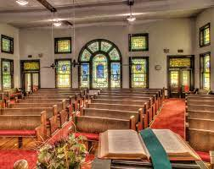
^{Dr. Doug Deuel}
^{“Am I in the Right Race”}

Slide 40
^{Hymn of}
^{Invitation}
^{P853}
When We All get to Heaven

Slide 41
Sing the wondrous love of Jesus, Sing His mercy and His grace;
In the mansions bright and blessed, He'll prepare for us a place.

Slide 42
When we all get to heaven,
What a day of rejoicing that will be!
When we all see Jesus,
We'll sing and shout the victory!

Slide 43
While we walk the pilgrim pathway, clouds will overspread the sky;
But when trav'ling days are over, not a shadow, not a sigh.

Slide 44
When we all get to heaven,
What a day of rejoicing that will be!
When we all see Jesus,
We'll sing and shout the victory!

Slide 45
Let us then be true and faithful,
Trusting, serving ev'ry day;
Just one glimpse of Him in glory, will the toils of life repay.

Slide 46
When we all get to heaven,
What a day of rejoicing that will be!
When we all see Jesus,
We'll sing and shout the victory!

Slide 47
Benediction
Dr. Doug Deuel

Slide 48


