Slide 1


Slide 2
Welcome To First Christian Church
June 13th
^{Dr. Doug Deuel}
^{“The Kingdom of God”}
GREETINGS
&
ANNOUNCEMENTS

Slide 3
^{Collin Flynn}
^{Call To}
^{Worship}
Sing praise to God, who heeds our tears.
Sing praise to God, who helps the afflicted.
Sing praise to God, who lifts up the oppressed.
Sing praise to God, who remembers the needy.

Slide 4
^{Collin Flynn}
^{Call To}
^{Worship}
Sing praise to God, who is worthy of our thanks!

Slide 5
^{Hymn of Praise}
^{Pg 4}
​
To God Be The Glory

Slide 6
To God be the glory, great things he hath done:
So loved he the world that he gave us his son,

Slide 7
Who yielded his life an atonement for sin,
And opened the life-gate that all may go in.

Slide 8
Praise the Lord, Praise the Lord, Let the earth hear his voice!
Praise the Lord, Praise the Lord, Let the people rejoice!

Slide 9
O come to the Father, through Jesus the Son,
and give him the glory, great things he hath done.

Slide 10
Oh, perfect redemption,
the purchase of blood,
to ev’ry believer the promise of God.

Slide 11
The vilest offender who truly believes,
that moment from Jesus a pardon receives.

Slide 12
Praise the Lord, Praise the Lord, Let the earth hear his voice!
Praise the Lord, Praise the Lord, Let the people rejoice!

Slide 13
O come to the Father, through Jesus the Son,
and give him the glory, great things he hath done.

Slide 14
Great things he hath taught us, great things he hath done,
and great our rejoicing through Jesus the Son,

Slide 15
But purer, and higher, and greater will be
Our wonder, our transport, when Jesus we see.

Slide 16
Praise the Lord, Praise the Lord, Let the earth hear his voice!
Praise the Lord, Praise the Lord, Let the people rejoice!

Slide 17
O come to the Father, through Jesus the Son,
And give him the glory, great things he hath done.

Slide 18
And give him the glory, great things he hath done.

Slide 19
Collin Flynn
Invocation
​
Loving God, we are yours. We come as we are, with our cares and concerns. We long to touch and find healing in your embrace.

Slide 20
Collin Flynn
Invocation
​Strengthen our faith and heal our brokenness, that we may worship you with joy. AMEN

Slide 21
Gloria Patri
Glory be to the Father,
And to the Son, and to the Holy Ghost:
As it was in the beginning,
is now and Ever shall be: world without end.
Amen. Amen

Slide 22

Chris Fluitt

Slide 23
Pastoral Prayer
&
Prayers of the
People
Our Father, who art in heaven, hallowed be your name. Thy kingdom come, Thy will be done, on earth as it is in heaven. Give us this day our daily bread, and forgive us our debts, as we forgive our debtors. Lead us not into temptation, but deliver us from evil, for thine is the kingdom, the power, and the glory, forever, Amen.

Slide 24
^{Hymn of Communion}
^{P386}
He Loves Me

Slide 25
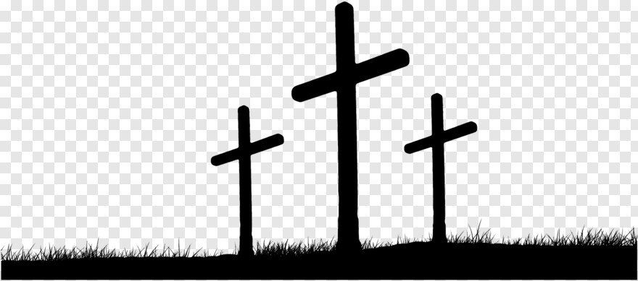
Why did the Savior heaven leave and come to earth below
Where men His grace would not receive?
Because He loves me so!

Slide 26
He loves me! He loves me!
He loves me this I know!
He gave Himself to die for me,
Because He loves me so!

Slide 27
Why did the Savior mark the way & why temptation know?
Why teach and toil and plead and pray?
Because He loves me so!

Slide 28
He loves me! He loves me!
He loves me this I know!
He gave Himself to die for me,
Because He loves me so!

Slide 29
Why feel the garden's dreadful dross?
Why through His trials go?
Why suffer death upon the cross?
Because He loves me so!

Slide 30
He loves me! He loves me!
He loves me this I know!
He gave Himself to die for me,
Because He loves me so!

Slide 31
He loves me! He loves me!
He loves me this I know!
He gave Himself to die for me,
Because He loves me so!

Slide 32
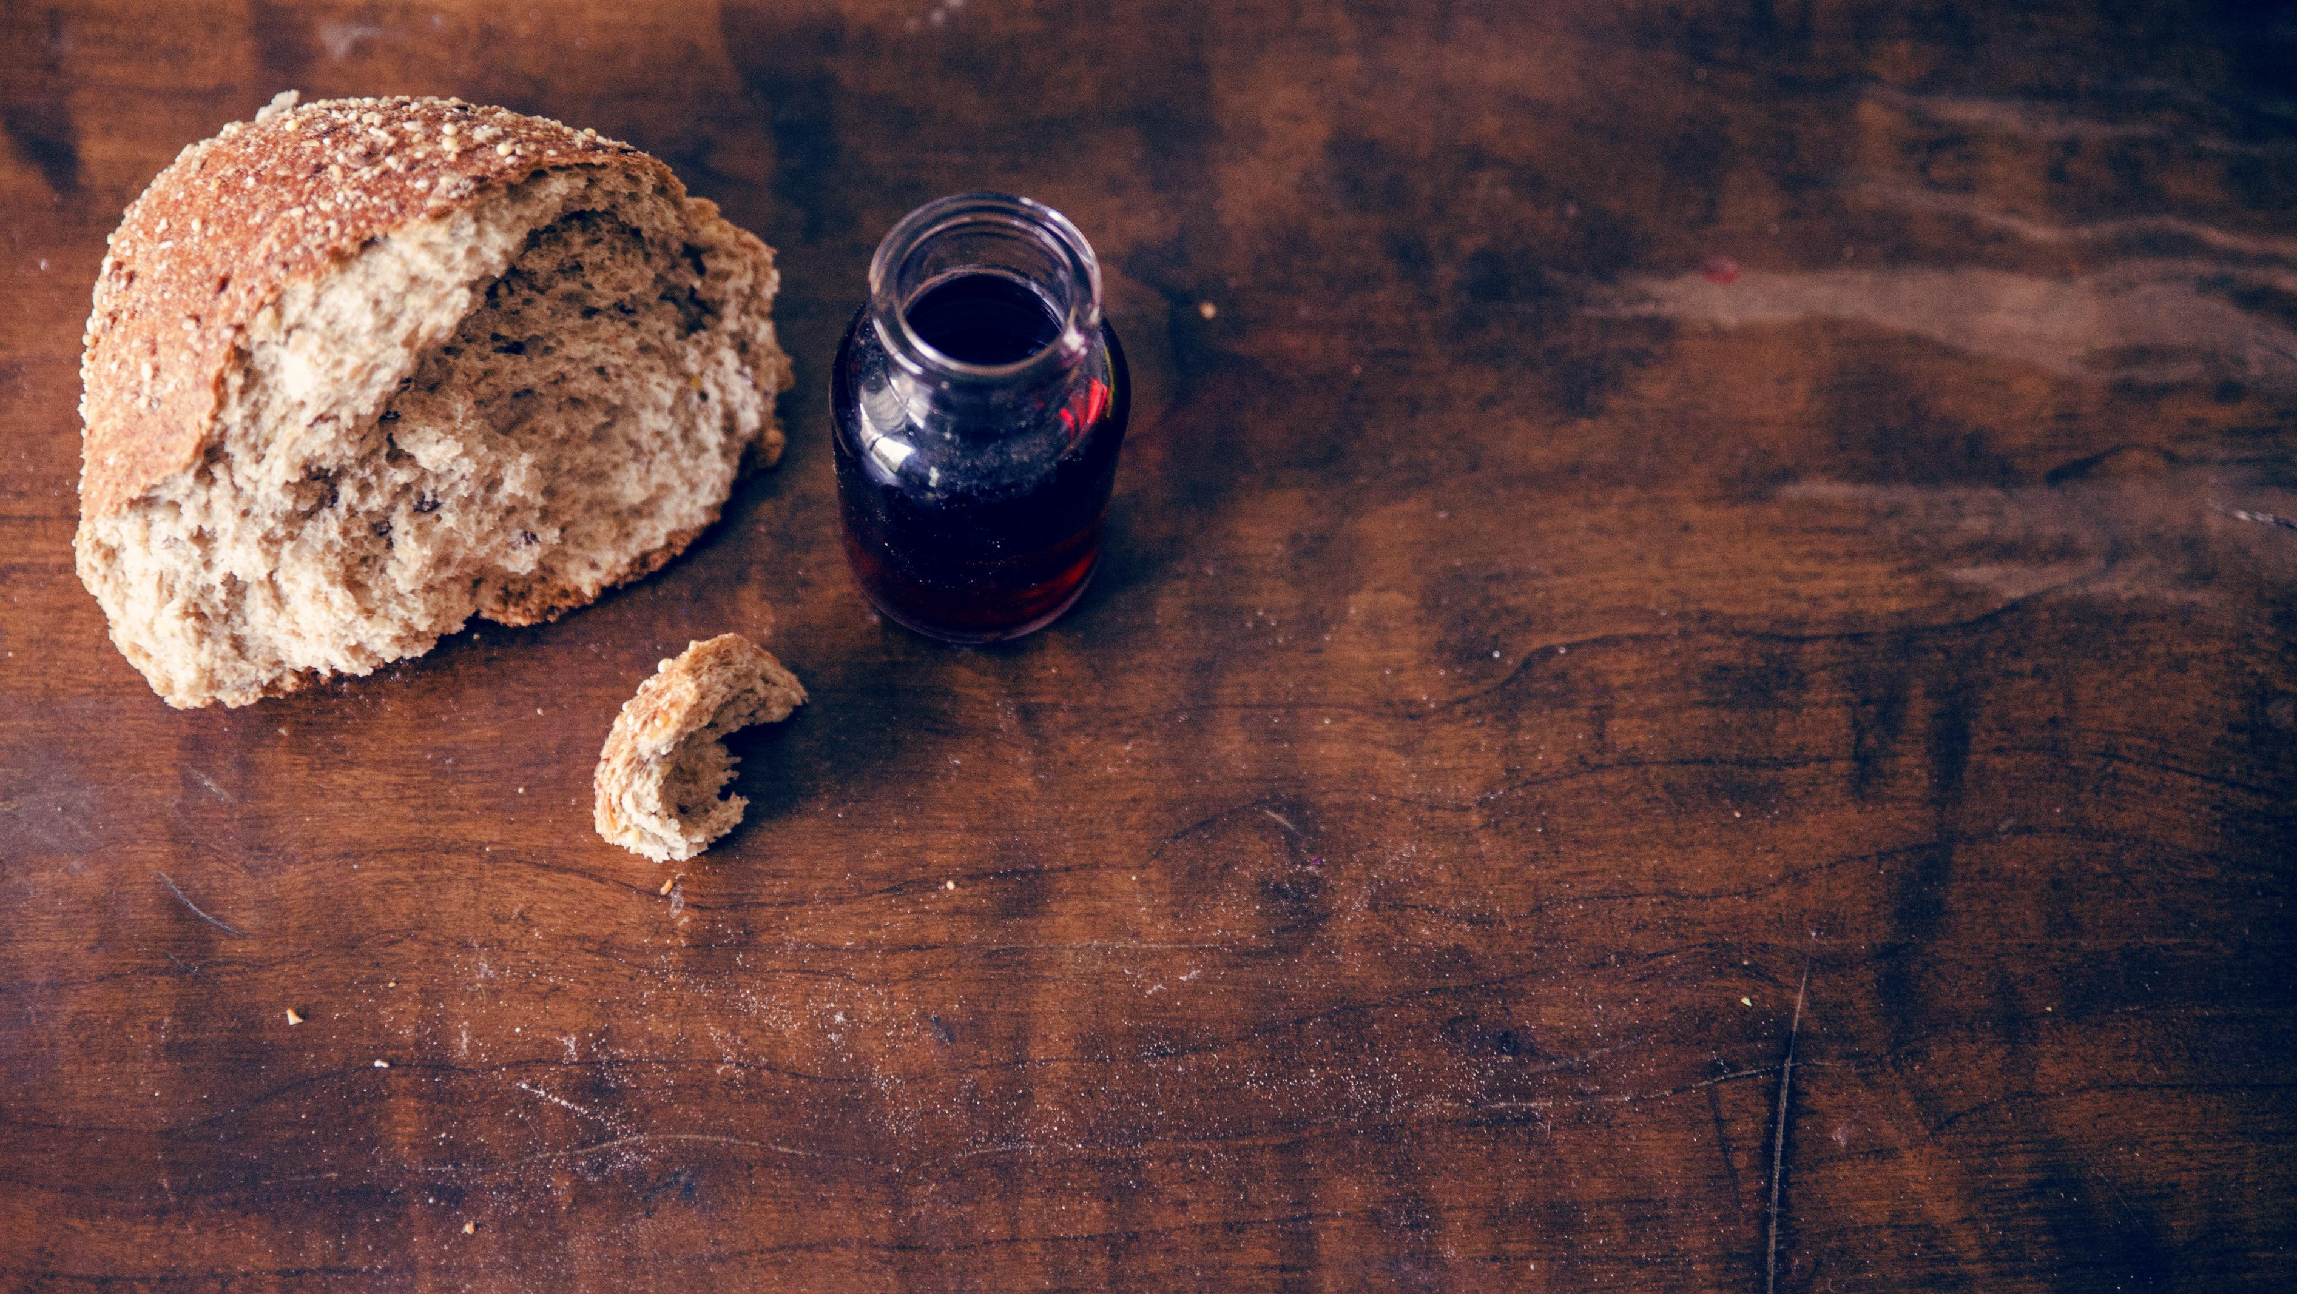
Invitation to the Table
Linda Wood & Ron Reed

Slide 33
Offering
Meditation
Collin Flynn
Paul challenged the church at Corinth to recognize their abundance, that they might share with those in need.

Slide 34
Offering
Meditation
Collin Flynn
God calls us to give out of our bounty, that all might have enough to live on without fear. With eager hearts, let us joyfully give out of our abundance.

Slide 35
Doxology
Praise God, from whom all blessings flow; Praise Him, all Creatures here below; Praise Him above, ye heav’nly host; Praise Father, Son, and Holy Ghost!

Slide 36
Prayer of
Dedication
Collin Flynn
Gracious God, we thank you for our present abundance and for the many blessings you have bestowed upon this

Slide 37
Prayer of
Dedication
Collin Flynn
community. We thank you for our faith, for our knowledge of you, and for the assurance of your

Slide 38
Prayer of
Dedication
Collin Flynn
love. May all these gifts be a blessing to those in need.
AMEN

Slide 39
Collin Flynn
^{Scripture}
^{Mark 4:26-32}
^{Pg 994}
26 He also said, “The kingdom of God is as if someone would scatter seed on the ground, 27 and would sleep and rise night & day, and the seed would sprout and grow, he does not know how.

Slide 40
Collin Flynn
^{Scripture}
^{Mark 4:26-32}
^{Pg 994}
30 He also said, “With what can we compare the kingdom of God, or what parable will we use for it?

Slide 41
Collin Flynn
^{Scripture}
^{Mark 4:26-32}
^{Pg 994}
31 It is like a mustard seed, which, when sown upon the ground, is the smallest of all the seeds on earth;

Slide 42
Collin Flynn
^{Scripture}
^{Mark 4:26-32}
^{Pg 994}
32 yet when it is sown it grows up and becomes the greatest of all shrubs, and puts forth large branches, so that the birds of the air can make nests in its shade.”

Slide 43
^{Special Music}
​
He Set Me Free,
Free Indeed

Slide 44
He that the son has set free
Is free indeed
He that the son has set free
Is free indeed

Slide 45
No more chains
No more slavery
Truth has come
And He has made me free

Slide 46
Once like a bird in prison I dwelt, no freedom from my sorrow I felt.
But Jesus came and listened to me, and glory to God
He set me free

Slide 47
He set me free,
Yes He set me free
He broke the bonds of prison for me
I’m glory bound my Jesus to see

Slide 48
Glory to God He set me free

Slide 49
He that the son has set free
Is free indeed
He that the son has set free
Is free indeed

Slide 50
No more chains
No more slavery
Truth has come
And He has made me free

Slide 51
Now I am climbing higher each day, darkness of night has drifted away.
My feet are planted on higher ground. Glory to God, I’m homeward bound.

Slide 52
He set me free,
Yes He set me free
He broke the bonds of prison for me
I’m glory bound my Jesus to see

Slide 53
Glory to God He set me free

Slide 54
He that the son has set free
Is free indeed

Slide 55
No more chains
No more slavery
Truth has come
And He has made me free

Slide 56
And He has made me free

Slide 57
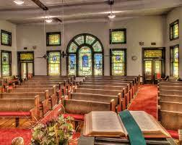
^{Dr. Doug Deuel}
^{“The Kingdom of God”}

Slide 58
^{Hymn of}
^{Invitation}
^{P586}
My Faith Looks up to Thee

Slide 59
My faith looks up to thee,
Thou Lamb of Calvary,
Savior divine:
Now hear me while I pray,
take all my guilt away,

Slide 60
O let me from this day
be wholly thine.

Slide 61
May thy rich grace impart
Strength to my fainting heart,
My zeal inspire;
As thou hast died for me,
O may my love to thee

Slide 62
Pure, warm, and changeless be, a living fire.

Slide 63
When ends life's transient dream,
When death's cold, sullen stream
Shall o'er me roll,

Slide 64
Blest Savior, then, in love,
fear and distrust remove;
O bear me safe above,
a ransomed soul.

Slide 65
My faith looks up to thee,
Thou Lamb of Calvary,
Savior divine:
Now hear me while I pray,
take all my guilt away,

Slide 66
O let me from this day
be wholly thine.

Slide 67
Benediction
Dr. Doug Deuel

Slide 68


