Slide 1


Slide 2
Welcome To First Christian Church June 20th ^{Dr. Doug Deuel} ^{“Contemporary Proverbs:} ^{Wisdom for Today’s Family”}
GREETINGS
&
ANNOUNCEMENTS

Slide 4
^{Collin Flynn} ^{Call To} ^{Worship}
Sing praise to God, who heeds our tears.
Sing praise to God, who helps the afflicted.
Sing praise to God, who lifts up the oppressed.
Sing praise to God, who remembers the needy.

Slide 5
^{Collin Flynn} ^{Call To} ^{Worship}
Sing praise to God, who is worthy of our thanks!

Slide 6
^{Hymn of Praise} ^{Pg 581}
​
I’d Rather Have Jesus

Slide 7
I'd rather have Jesus than silver or gold;
I'd rather be His than have riches untold;

Slide 8
I'd rather have Jesus than houses or lands.
I'd rather be led by His nail pierced hand

Slide 9
Than to be the king of a vast domain
Or be held in sin's dread sway.

Slide 10
I'd rather have Jesus than anything
This world affords today.

Slide 11
I'd rather have Jesus than men's applause;
I'd rather be faithful to His dear cause;

Slide 12
I'd rather have Jesus than worldwide fame.
I'd rather be true to His holy name

Slide 13
Than to be the king of a vast domain
Or be held in sin's dread sway.

Slide 14
I'd rather have Jesus than anything
This world affords today.

Slide 15
Than to be the king of a vast domain
Or be held in sin's dread sway.

Slide 16
I'd rather have Jesus than anything
This world affords today.

Slide 17
I'd rather have Jesus than anything
This world affords today.

Slide 18
Collin Flynn Invocation
​
Faithful, forgiving Father of new beginnings, we enter your house this day
surrounded by your steadfast love.

Slide 19
Collin Flynn Invocation
​Gentle, embracing Mother of encouragement, we hear your voice this hour in the words spoken & the movement of the spirit in our hearts.

Slide 20
Collin Flynn Invocation
​
Let your will be known, for we would be your people, even as you are our God.
AMEN

Slide 21
Gloria Patri
Glory be to the Father,
And to the Son, and to the Holy Ghost:
As it was in the beginning,
is now and Ever shall be: world without end.
Amen. Amen

Slide 22

Jess Snyder

Slide 23
Pastoral Prayer & Prayers of the People
Our Father, who art in heaven, hallowed be your name. Thy kingdom come, Thy will be done, on earth as it is in heaven. Give us this day our daily bread, and forgive us our debts, as we forgive our debtors. Lead us not into temptation, but deliver us from evil, for thine is the kingdom, the power, and the glory, forever, Amen.

Slide 24
^{Hymn of Communion}
How Great is Our God

Slide 25

The splendor of a King,
Clothed in majesty,
Let all the Earth rejoice,
All the Earth rejoice

Slide 26
He wraps himself in light,
And darkness tries to hide,
And trembles at His voice,
Trembles at His voice

Slide 27
How great is our God,
sing with me
How great is our God,
and all will see
How great,
how great is our God!

Slide 28
Age to age He stands,
And time is in His hands,
Beginning and the end,
Beginning and the end

Slide 29
The Godhead 3 in 1,
Father Spirit Son,
The Lion and the Lamb
The Lion and the Lamb

Slide 30
How great is our God,
sing with me
How great is our God,
and all will see
How great,
how great is our God!

Slide 31
Name above all names,
Worthy of our praise,
My heart will sing
How great is our God

Slide 32
How great is our God,
sing with me
How great is our God,
and all will see
How great,
how great is our God!

Slide 33
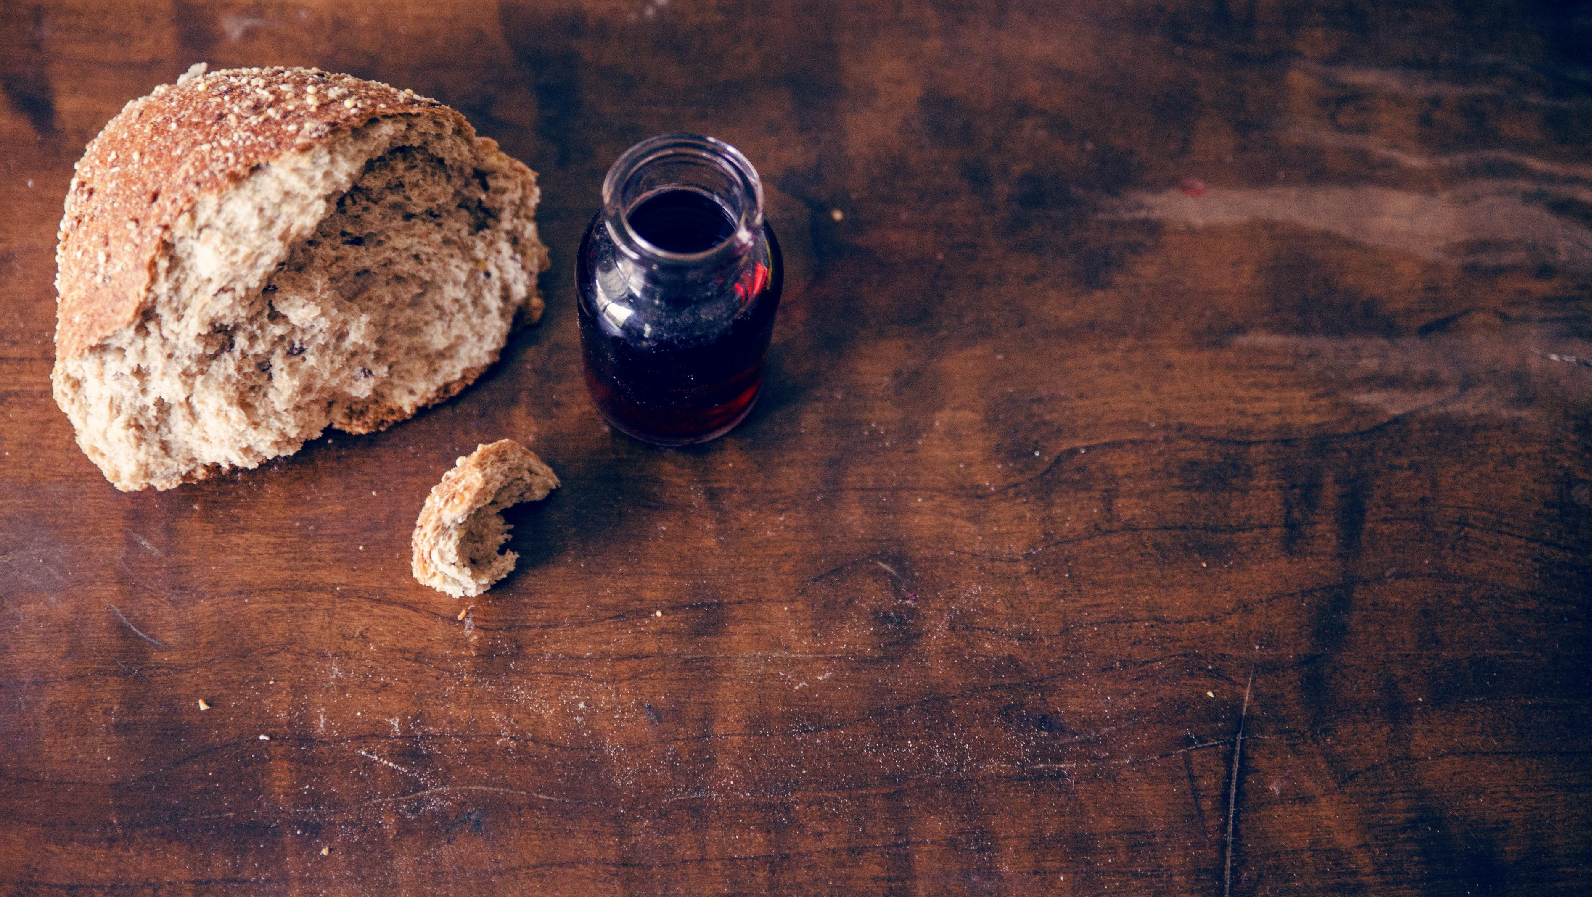
Invitation to the Table
Linda Wood & Cathy Cox

Slide 34
Offering Meditation Collin Flynn
God has given us this amazing earth. God has given us this amazing life.

Slide 35
Offering Meditation Collin Flynn
Let us show our gratitude by returning a portion of God’s gifts to the church and to its
work in the world.

Slide 36
Doxology
Praise God, from whom all blessings flow; Praise Him, all Creatures here below; Praise Him above, ye heav’nly host; Praise Father, Son, and Holy Ghost!

Slide 37
Prayer of Dedication Collin Flynn
Creator God, your gifts overwhelm us, We thank you for sharing this amazing
creation with us.

Slide 38
Prayer of Dedication Collin Flynn
We praise you for the glory of being created in your very image.

Slide 39
Prayer of Dedication Collin Flynn
We pray that these gifts may reflect the glory of your image and go forth to truly
bless your creation upon this earth. AMEN

Slide 40
Collin Flynn ^{Scripture} ^{John 15:14-15}
14 You are my friends if you do what I command you. 15 I do not call you
servants any longer, because the servant does not know what the master is doing;

Slide 41
Collin Flynn ^{Scripture} ^{Mark 4:26-32} ^{Pg 994}
but I have called you friends, because I have made known to you
everything that I have heard from my Father.

Slide 42
^{Special Music}
​
Good, Good Father

Slide 43
I've heard a thousand stories of what they think you're like
But I've heard the tender whisper of love in the dead of night

Slide 44
And you tell me
that you're pleased
And that I'm never alone

Slide 45
You're a Good, Good Father
It's who you are, it's who you are, it's who you are
And I'm loved by you
It's who I am, it's who I am, it's who I am

Slide 46
I've seen many searching
for answers far and wide
But I know we're all searching
For answers only you provide

Slide 47
'Cause you know
just what we need
Before we say a word

Slide 48
You're a Good, Good Father
It's who you are, it's who you are, it's who you are
And I'm loved by you
It's who I am, it's who I am, it's who I am

Slide 49
You are perfect
in all of your ways
You are perfect
in all of your ways
You are perfect
in all of your ways to us

Slide 50
You are perfect
in all of your ways
You are perfect
in all of your ways
You are perfect
in all of your ways to us

Slide 51
It's love so undeniable
I, I can hardly speak
Peace so unexplainable
I, I can hardly think

Slide 52
As you call me deeper still
As you call me deeper still
As you call me deeper still
Into love, love, love

Slide 53
You're a Good, Good Father
It's who you are, it's who you are, it's who you are
And I'm loved by you
It's who I am, it's who I am, it's who I am

Slide 54
You are perfect
in all of your ways
You are perfect
in all of your ways
You are perfect
in all of your ways to us

Slide 55
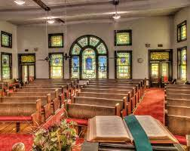
^{Dr. Doug Deuel} ^{“Contemporary Proverbs:} ^{Wisdom for Today’sFamily}

Slide 56
^{Hymn of} ^{Invitation}
They’ll Know We are
Christians

Slide 57
We are one in the Spirit,
We are one in the Lord
We are one in the Spirit,
We are one in the Lord
And we pray that all unity may one day be restored

Slide 58
And they'll know we are Christians by our love, by our love
Yes they’ll know we are Christians by our love

Slide 59
We will walk with each other, We will walk hand in hand
We will walk with each other, We will walk hand in hand
And together we'll spread the news that God is in our land

Slide 60
And they'll know we are Christians by our love, by our love
Yes they’ll know we are Christians by our love

Slide 61
We will work with each other, We will work side by side
We will work with each other, We will work side by side

Slide 62
And we'll guard each one's dignity
And save each one's pride

Slide 63
And they'll know we are Christians by our love, by our love
Yes they’ll know we are Christians by our love

Slide 64
All praise to the Father,
from whom all things come;
And all praise to Christ Jesus, His only Son.
And all praise to the Spirit who makes us one.

Slide 65
And they'll know we are Christians by our love, by our love
Yes they’ll know we are Christians by our love

Slide 66
And they'll know we are Christians by our love, by our love
Yes they’ll know we are Christians by our love

Slide 67
Benediction Dr. Doug Deuel

Slide 68


