Slide 1


Slide 2
Welcome To First Christian Church June 27th ^{Dr. Doug Deuel} ^{“Don’t Worry Be Happy”}
GREETINGS
&
ANNOUNCEMENTS

Slide 3
^{Collin Flynn} ^{Call To} ^{Worship}
As the deep calls to the deep in thundering waves of faith and steadfast love, so we stand on the mountain with Elijah, feeling billowing waves of God’s power flowing over and through us.

Slide 4
^{Collin Flynn} ^{Call To} ^{Worship}
Set aside your enemies, the people, thoughts, time, and challenges that separate you from knowing God’s love.

Slide 5
^{Collin Flynn} ^{Call To} ^{Worship}
Clothe yourselves in Christ. Shout praise in his name, and declare how much God has done for you.

Slide 6
^{Hymn of Praise} ^{Pg 6} ^{Verses 1,3,4}
​
All Creatures of Our God and King

Slide 7
All creatures worship God most high,
Lift up your voice in earth and sky,
alleluia, alleluia!

Slide 8
Thou burning sun with golden beam,
Thou silver moon with softer gleam,
O praise Him! O praise Him!
Alleluia! Alleluia! Alleluia!

Slide 9
And all ye men of tender heart,
Forgiving others, take your part,
Alleluia! Alleluia!

Slide 10
Ye who long pain and sorrow bear,
Praise God and on Him cast your care!
O praise Him! O praise Him!
Alleluia! Alleluia! Alleluia!

Slide 11
Let all things their Creator bless,
And worship Him in humbleness,
O praise Him! Alleluia!

Slide 12
Praise, praise the Father, praise the Son,
And praise the Spirit, Three in One!
O praise Him! O praise Him!
Alleluia! Alleluia! Alleluia!

Slide 13
Collin Flynn Invocation
​God of mystery, open our eyes, to look for you in unfamiliar places; open our
eyes; open our ears, to hear you speak in the sound of sheer silence;

Slide 14
Collin Flynn Invocation
​Open our hearts, to feel the depth of your love. When we wander in the wilderness of fear and death, revive us with your care, that we may find strength for our journey
back to the land of hope and life. Amen

Slide 15
Gloria Patri
Glory be to the Father,
And to the Son, and to the Holy Ghost:
As it was in the beginning,
is now and Ever shall be: world without end.
Amen. Amen

Slide 16

Jess Snyder

Slide 17
Pastoral Prayer & Prayers of the People
Our Father, who art in heaven, hallowed be your name. Thy kingdom come, Thy will be done, on earth as it is in heaven. Give us this day our daily bread, and forgive us our debts, as we forgive our debtors. Lead us not into temptation, but deliver us from evil, for thine is the kingdom, the power, and the glory, forever, Amen.

Slide 18
^{Hymn of Communion} ^{pg 383}
Jesus Keep Me Near The Cross

Slide 19

Jesus, keep me near the cross,
There a precious fountain,
Free to all—a healing stream,
Flows from Calv’ry’s mountain.

Slide 20
In the cross, in the cross,
Be my glory ever;
Till my raptured soul shall find
Rest beyond the river

Slide 21
Near the cross, a trembling soul,
Love and mercy found me;
There the Bright and Morning Star
Sheds its beams around me.

Slide 22
In the cross, in the cross,
Be my glory ever;
Till my raptured soul shall find
Rest beyond the river

Slide 23
Near the cross! O Lamb of God,
Bring its scenes before me;
Help me walk from day to day,
With its shadow o’er me.

Slide 24
In the cross, in the cross,
Be my glory ever;
Till my raptured soul shall find
Rest beyond the river

Slide 25
Till my raptured soul shall find
Rest beyond the river

Slide 26
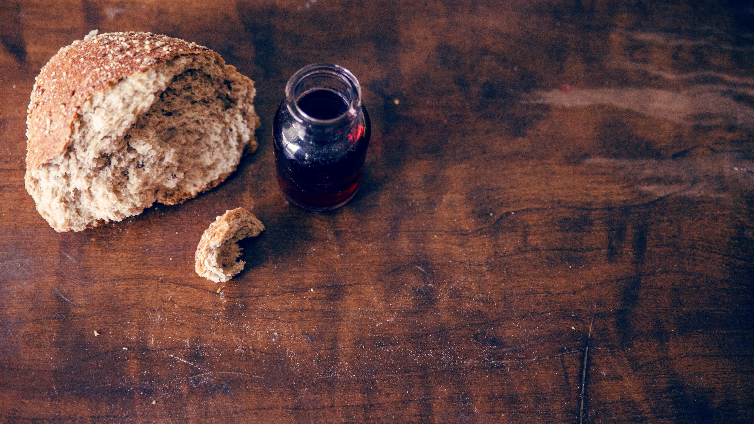
Invitation to the Table
Linda Wood & Ron Reed

Slide 27
Offering Meditation Collin Flynn
Be zealous in shouting your praises to the Lord. Remembering the strength of God’s love and the promise of Christ’s help.

Slide 28
Offering Meditation Collin Flynn
Let us share who we are as the church in the world. With open arms, let us join with one another as we express our faith through our gifts of love.

Slide 29
Doxology
Praise God, from whom all blessings flow; Praise Him, all Creatures here below; Praise Him above, ye heav’nly host; Praise Father, Son, and Holy Ghost!

Slide 30
Prayer of Dedication Collin Flynn
Sovereign God, you feed us by your own hand, lest our souls shrivel for want of
nourishment;

Slide 31
Prayer of Dedication Collin Flynn
you receive us with the waters of life, lest our hearts faint in the desert of our despair;

Slide 32
Prayer of Dedication Collin Flynn
You call us back to life and new possibilities, lest our hopes fail in our sorrow and anguish.

Slide 33
Prayer of Dedication Collin Flynn
Accept these offerings, in gratitude & praise, for the many blessings we have received from your hand.

Slide 34
Prayer of Dedication Collin Flynn
Accept the gift of our love, and our pledge to love others as you have loved us. AMEN

Slide 35
Collin Flynn ^{Scripture} ^{Matthew 6:25-26}
“Therefore I tell you, do not worry about your life, what you will eat or what you will drink, or about your body, what you will wear. Is not life more than food, and the body more than clothing?

Slide 36
Collin Flynn ^{Scripture} ^{Matthew 6:25-26}
26 Look at the birds of the air; they neither sow
nor reap nor gather into barns, and yet your heavenly Father feeds them. Are you not of more value than they?

Slide 37
^{Special Music}
Jesus is the Answer

Slide 38
Jesus is the answer for the world today
Above him there’s
no other
Jesus is the Way

Slide 39
If you have some questions in the corner of your mind
And traces of discouragement and peace you cannot find

Slide 40
Reflections of the old past, seem to face you everyday
There's one thing I know for sure is that
Jesus is the way!

Slide 41
Jesus is the answer for the world today
Above him there’s
no other
Jesus is the Way

Slide 42
I know you’ve got mountains
That you think you cannot climb
I know your skies are dark
And you think the sun won’t shine

Slide 43
But in case you didn’t know
The Word of God is true
Everything He’s promised
He will do it for you

Slide 44
Jesus is the answer for the world today
Above him there’s
no other
Jesus is the Way

Slide 45
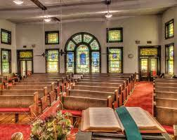
^{Dr. Doug Deuel} ^{“Don’t Worry Be Happy"}

Slide 46
^{Hymn of} ^{Invitation} ^{p36}
My Tribute

Slide 47
To God be the glory To God be the glory To God be the glory For the things He has done

Slide 48
With His blood
He has saved me With His power
He has raised me To God be the glory For the things He has done

Slide 49
How can I say thanks For the things You have done for me?

Slide 50
Things so undeserved Yet You gave to prove Your love for me.

Slide 51
The voices of a million angels, Could not express my gratitude

Slide 52
All that I am and ever hope to be I owe it all to Thee

Slide 53
To God be the glory To God be the glory To God be the glory For the things He has done

Slide 54
With His blood
He has saved me With His power
He has raised me To God be the glory For the things He has done

Slide 55
Let me live my life Let it pleasing, Lord to Thee, & if I gain any praise let it go to Calvary

Slide 56
With His blood
He has saved me With His power
He has raised me To God be the glory For the things He has done

Slide 57
To God be the glory For the things He has done

Slide 58
Benediction Dr. Doug Deuel

Slide 59


