Slide 1
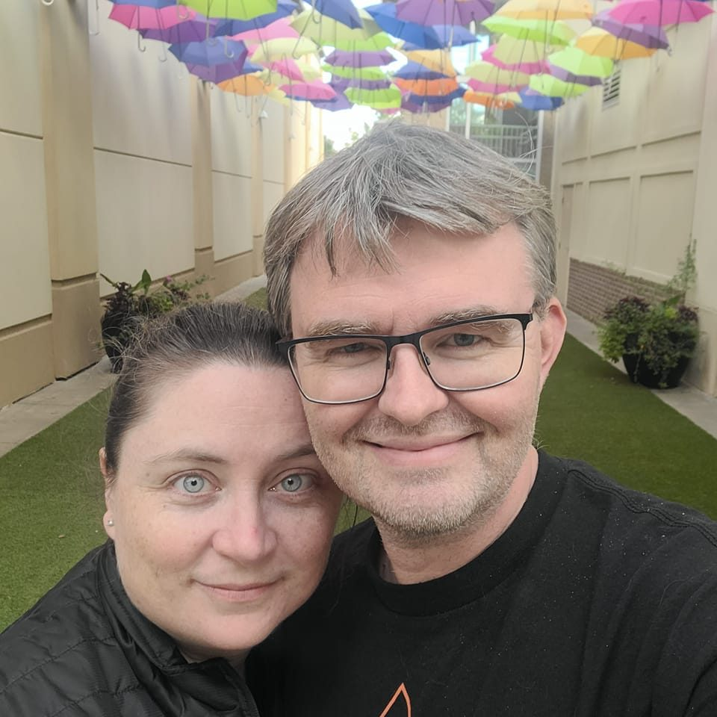
Ministry Profile
Chris Fluitt
Notes:
[Sources] - Ministry Profile (provided by candidate), PDF generated 01/15/2026. [/Sources]

Slide 2
Chris Fluitt
Married (17 years) with five kids
46 years old
In full-time ministry since 2001 (ordained since 2013)
Ordained in the Christian Church (Disciples of Christ), December 2025
Source: Ministry Profile (pages 8–9)
Notes:
[Sources] - Ministry Profile (provided by candidate), pages 8–9. [/Sources]

Slide 3
River City Church
Waco, TX | Music Director (01/2001–04/2004)
Led worship and developed teams through recruiting and training
Directed a weekly worship choir (~50) and guided a shift to contemporary worship
Served during a season of growth from ~75 to ~200
Source: Ministry Profile (pages 8–9)
Notes:
[Sources] - Ministry Profile (provided by candidate), pages 8–9. [/Sources]

Slide 4
Anchor Church
Keller, TX | Worship Assistant (07/2004–02/2006)
Led worship in a contemporary team setting
Helped plan seeker-driven services and coordinated scheduling/music for a team of ~40
Served during a growth season from ~100 to ~400
Source: Ministry Profile (pages 8–9)
Notes:
[Sources] - Ministry Profile (provided by candidate), pages 8–9. [/Sources]

Slide 5
Tabernacle of Praise
Kennedale, TX | Worship Pastor (05/2006–04/2012)
Recruited and trained a worship team, growing from 5 to 30
Directed a weekly worship choir (~20) and led multiple music styles
Served during a season of attendance growth from ~40 to ~90
Source: Ministry Profile (pages 8–9)
Notes:
[Sources] - Ministry Profile (provided by candidate), pages 8–9. [/Sources]

Slide 6
Redemption Church
Plano, TX | Worship Pastor / Lead Pastor (04/2012–Present)
Planted Redemption Church with no denominational backing
Built teams and systems (worship team from scratch; next-steps pipeline for volunteers)
Focused on relevant preaching and measurable growth (baptisms, increased giving and attendance)
Source: Ministry Profile (pages 8–9)
Notes:
[Sources] - Ministry Profile (provided by candidate), pages 8–9. [/Sources]

Slide 7
First Christian Church
Van Alstyne, TX | Worship Pastor / Music Director (12/2020–Present)
Helped the church navigate Covid and stabilize ministry
Helped grow attendance from ~50 to 100+
Modernized worship and tech (updated instrumentation, new sound system, screens)
Source: Ministry Profile (pages 8–9)
Notes:
[Sources] - Ministry Profile (provided by candidate), pages 8–9. [/Sources]

